Slide 1
Diseases and Vaccines
New & old
Professor Robert Booy
National Centre Immunisation Research & Surveillance, University of Sydney
and Marie Bashir Institute

Slide 2
What would be an ideal vaccine?
Single dose
at birth
life-long
very safe
simple eg oral/topical
cheap
no cold-chain
no HCW

Slide 3

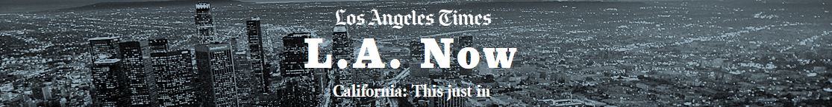
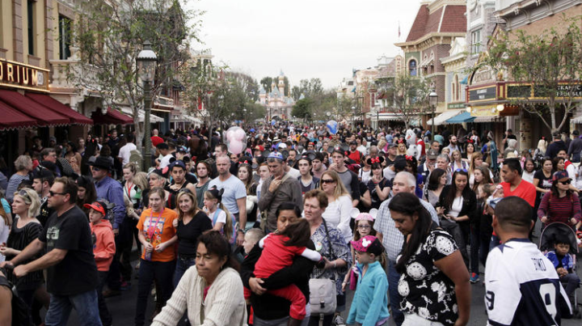
Measles was declared as Eliminated in Australia in 2014
Of the 119 cases in California, at least 39 can be directly linked to visitors or employees at Disneyland during the holidays, 27 were family members or people who came in close contact with someone who had the measles, and at least eight caught the measles by being in a public area such as an emergency room where a confirmed case was present

Slide 4
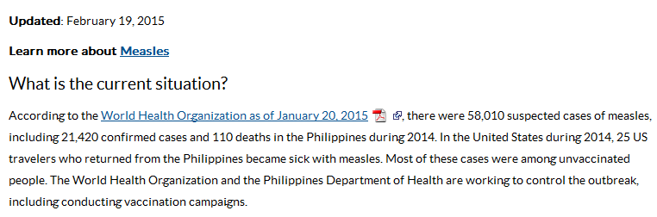
CDC Travel - http://wwwnc.cdc.gov/travel/

Slide 5
Measles Outbreak Alert
Were you born after 1965?
Have you received two doses of MMR? (Measles/Mumps/Rubella)
You could get measles!
Yes
Don’t Know/Maybe/No
Ask your GP today if you need another MMR
Make sure your kids are up to date with their immunisations too

Slide 6

Measles
The second dose of MMR can be given as early as 4 weeks (28 days) after the first dose and be counted as a valid dose if both doses were given after the child's first birthday
The second dose is not a booster, but intended to produce immunity in the small number of people who fail to respond to the first dose

Slide 7
Fluvax given to under 5s despite ban
Warning from CMO.. May 2015
three cases in NSW,
three in Queensland,
one in South Australia
two in West Australia
National vaccination delayed until April 21 so an appropriate vaccine was available for <5 yr olds
Impact on risk groups? Elderly, cancer…

Slide 8
Pertussis vaccine in 2015
Government’s recent addition of DTPa vaccine for children aged 18 months to the National Immunisation Program to boost individual and community immunity
‘No Jab, No Pay’ policy: ? positive impact on increasing overall childhood vaccination rates
Low level of adult immunisation:
To protect young babies, Pertussis booster, particularly new and expectant parents but also grandparents, childcare workers & HCWs

Slide 9

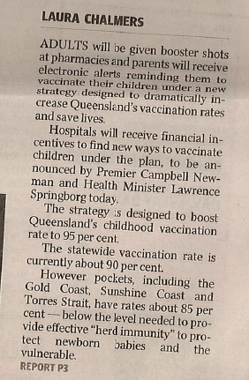

A vaccination APP to remind parents when their child’s shots are due and $3 million in financial incentives for hospital and health services that find innovative new ways to vaccine kids

Slide 10
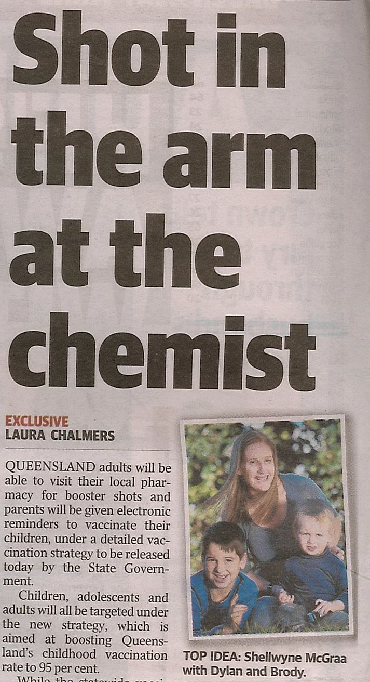
The expansion of a pharmacy vaccination trial to allow Queensland adults to now receive the flu& whooping cough - esp’ly pregnant Mums

Slide 11
Children under 6 months of age are at greatest risk of Pertussis
  Without boosting in pregnancy, few women pass on protective levels of antibodies to their babies so most babies are born without immunity and remain susceptible to Pertussis until they receive 1-2 vaccines
  One dose reduces risk of death in infants
  The Centers for Disease Control and Prevention’s (CDC’s) Advisory Committee on Immunization Practices (ACIP) recommended vaccination of pregnant women 2011, & in Oct 2012 recommended vaccination every pregnancy
  The UK introduced the third trimester booster in October 2012 - It reduced disease by 91%, Safe in pregnancy
  Australia has followed suit..

Slide 12
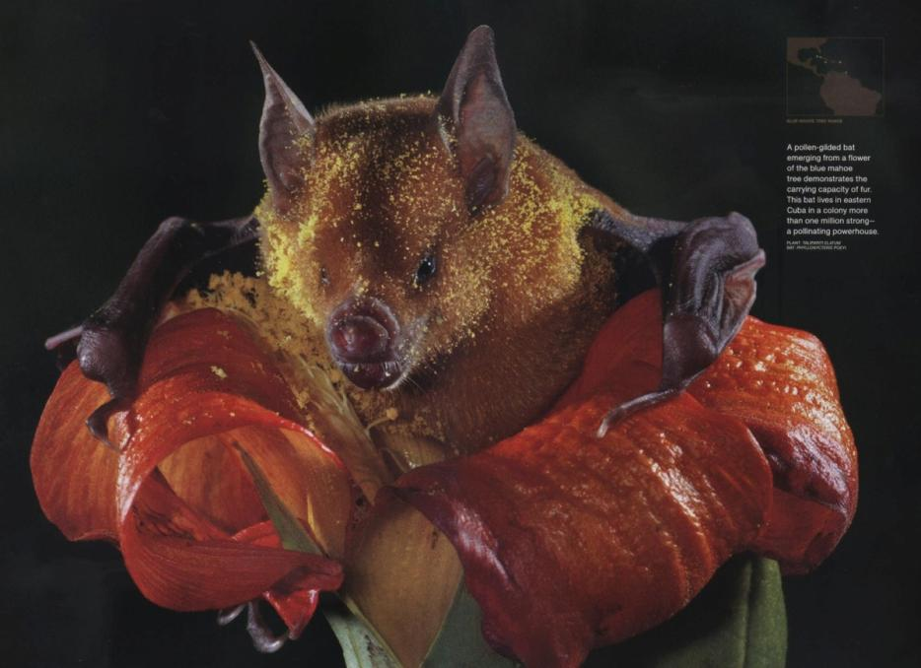

Bats carry more viruses than any other mammal

Slide 13

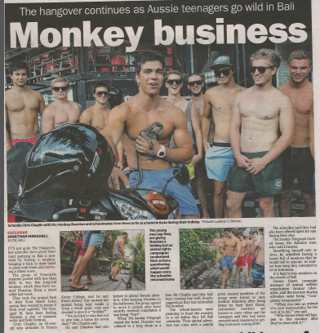
Rabies & Lyssavirus
The fearlessness and folly of youth

Slide 14
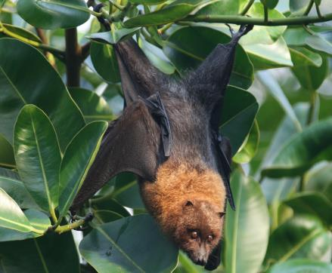
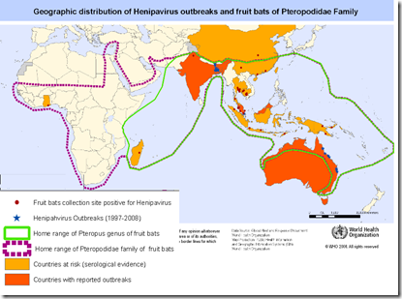
Rabies
Order: Chiroptera
Suborder: Megachiroptera ("megabats")
Family: Pteropodidae (flying foxes, Old World fruit bats)
Transmits Hendra, Lyssa

Slide 15
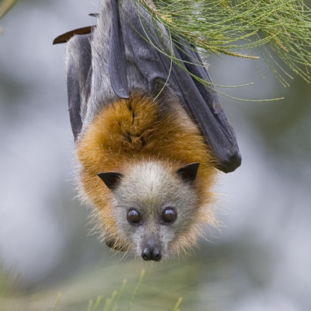
Rabies is called ABLV in Australia
3 cases: all in QLD when are they dangerous?
Grey-headed flying fox
Local to NSW coast
May carry Hendra, ABLV ie Lyssa, Menangle viruses etc
Briggs et al Bull WHO 2000
Excellent antibody responses of patients after post-exposure rabies intradermal vaccination

Slide 16
Rabies
Lyssavirus: RNA virus
11 Lyssavirus species
  Classic Rabies virus (RABV) : genotype 1
  Australian bat Lyssavirus (ABLV): genotype 7
RABV causes most human rabies globally
  transmitted predominantly by dogs (Asia / Africa)
  racoons / skunks / foxes / coyotes / beavers (USA / Europe)
  bat-variant sub-lineages
  best control: mass vaccination dogs / managing dog population
Bali aims to be rid of Rabies by 2020..

Slide 17
Rabies in Australia
August 1996: bitten by macro-bat
  rabies November 1998
October 1996: bitten by yellow sheathed micro-bat
  rabies November 1996
Animals:
  more aggressive or more tame / lose fear of people
  nocturnal bats may be out during the day, found on ground / unable to fly
  dogs: stagger, tremble, seem weak
Allworth, A et al. A human case of encephalitis due to a Lyssavirus recently identified in fruit bats. CDI, 20, 504. 1996
Hanna JN et al. Australian bat lyssavirus infection: a second human case with a long incubation period. MJA 172, 597-599. 2000

Slide 18
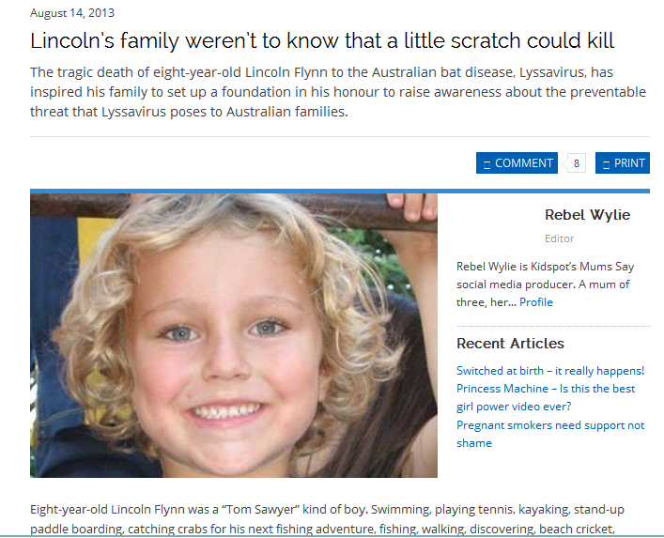
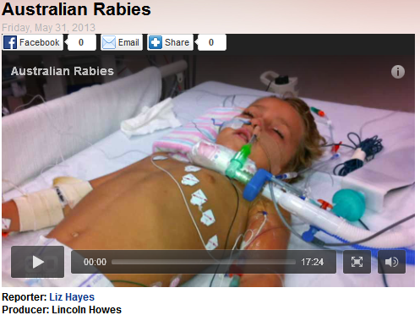
4.16 RABIES AND OTHER LYSSAVIRUSES (INCLUDING AUSTRALIAN BAT LYSSAVIRUS)
  Early: non-specific: fever, headache, malaise
  As progresses: insomnia, anxiety, confusion, paralysis, excitation, hallucinations, agitation, hypersalivation, difficulty swallowing, hydrophobia Death within days of CNS symptoms
Notes:
18
December 2012

Slide 19
Rabies in Bali/Indonesia: now endemic
1st cases reported in Indonesia in 1884 – present in 24 of 33 provinces
  Bali from 2008 - Very slow local action: >130 deaths by 2011 (no PEP)
  Improved dog vaccination / control & PEP >130,000: has ↓ deaths
  Australia provided DFA test in Denpasar
Macaque bites more prominent than dog bites in Bali
  No evidence as yet that they transmit rabies
Visitors strongly advised: avoid direct contact with dogs, cats, monkeys – avoid cute animals
RIG shortage in developing countries
  Some still don’t receive RIG in Bali / too late for RIG on return
Not enough travellers receive pre-travel vaccination
  Expensive
P. Gautret, P. L. Lim, M. Shaw, K. Leder. Rabies post-exposure prophylaxis in travellers returning from Bali, Indonesia, November 2008 to March 2010. Clinical Microbiology and Infection Volume 17, Issue 3, pages 445–447, March 2011
Gautret, P. L. Lim, M. Shaw, K. Leder Rabies post-exposure prophylaxis in travellers returning from Bali, Indonesia, November 2008 to March 2010. Clinical Microbiology and Infection Volume 17, Issue 3, pages 445–447, March 2011
http://smartraveller.gov.au/zw-cgi/view/Advice/Indonesia

Slide 20

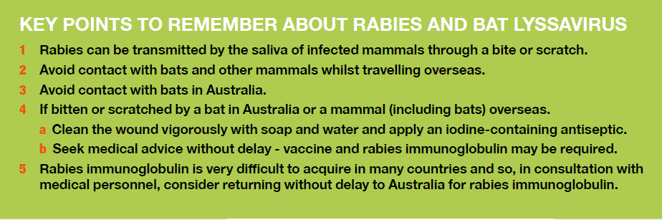


Slide 21
Rabies treatment: wound care and vaccine
Wound care VIP: scrub with soap & water for 15 minutes
Current vaccines interchangeable
  Human diploid cell derived (HDCV): Merieux
  Purified chick embryo cell derived (PCECV): Rabipur
  Classic Rabies and ABLV: cross protection by vaccine conferred
Pre-exposure prophylaxis
  1.0 mL IM injection days 0, 7 and 28
  HDCV can be given subcut
Post-exposure treatment
  1.0 mL vaccine by IM injection on days 0, 3, 7, 14 and 28–30
  Human RIG 20 IU/kg body mass: infiltrate wounds and remainder of dose IM: within 7 days of injury
P.T. Hooper et al. A new lyssavirus - fhe first endemic rabies-related virus recognized in Australia. Bull. Inst. Pasteur. 1997, 95, 209-218
http://immunise.health.gov.au/internet/immunise/publishing.nsf/Content/Handbook-lyssavirus

Slide 22
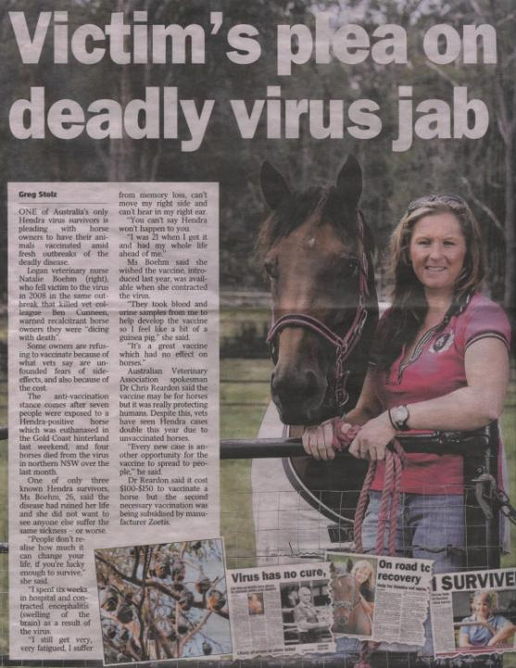
Hendra virus, known since 1994, a relative of measles, is not always fatal
(CFR 4/7cases) Cryptic cases may be occurring so better encephalitis surveillance is relevant
Bats transmit to horses and horses transmit to humans: pneumonitis And encephalitis

Slide 23
NEW Infectious Disease Threats

Slide 24
The Age of Contagion
Zoonotic diseases (eg MERS, SARS, Monkeypox and West Nile virus) are responsible for 75% of new human infectious diseases
21st century – human and animal interaction in a deteriorating environment
Growing need to adopt a One Health approach to threats
One Health Strategy – prevention rather than cure
Integrated surveillance system: humans, animals, food, and environment
Enable vision of potential risks as they begin – creating opportunity for prevention
One Health academic & research programs to train health professionals

Slide 25
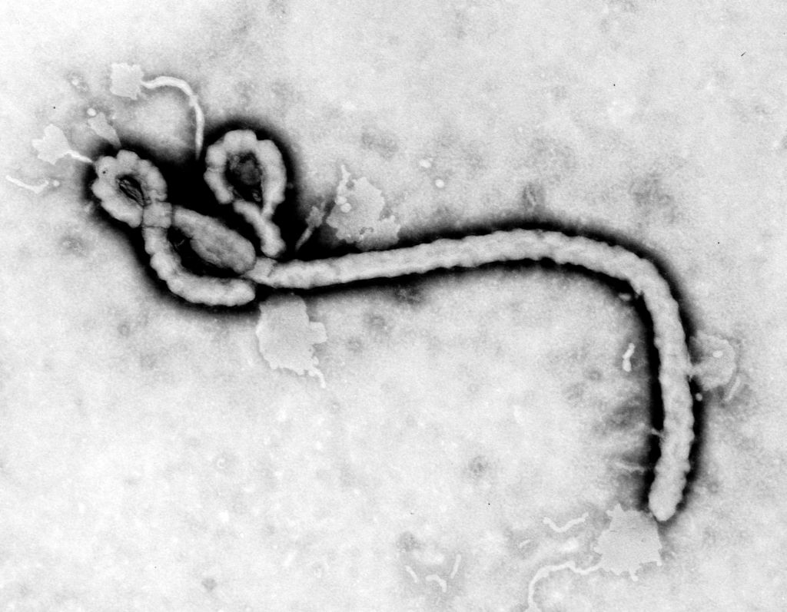
What virus is this?
Putative sources of human epidemic: bites/scratches from, or eating the meat of, Bats or monkeys

Slide 26
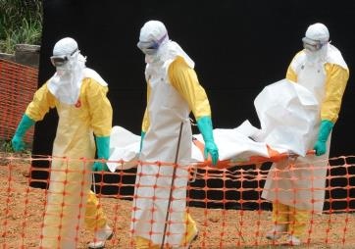
Ebola: no proven cure or vaccine critical to quarantine
By 2015, 25,000 cases & about 10,000 deaths – largest outbreak ever recorded
Ebola is usually both rare and very deadly
Virus starts off with flu-like symptoms and ends with horrific bleeding….
Doctors Without Borders: “overwhelmed” by May 2014
epidemic out of control
Disease without borders!
Never before in three countries Sierra Leone, Liberia, Guinea
  AND never before in capital cities
  AND spread by plane..
Staff of “Doctors without Borders” carry the body of a deceased person at a centre in Guinea

Slide 27
June 2015 NIH research
Three monkeys infected with the 1976 virus developed symptoms roughly two days earlier than three monkeys infected with the current pathogen
"The most notable difference was progression," the study said " the virulence ... is not increased compared with other (Ebola) strains."
Fauci of NIH said, the virus spun out of control in Liberia, Sierra Leone and Guinea because of a "perfect storm" of factors where it took root in densely populated cities and victimized poverty-stricken nations with poor health care and porous borders

Slide 28
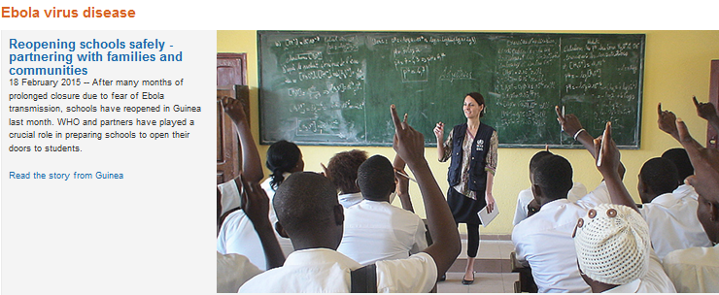
Schools re-opened 2015

Slide 29
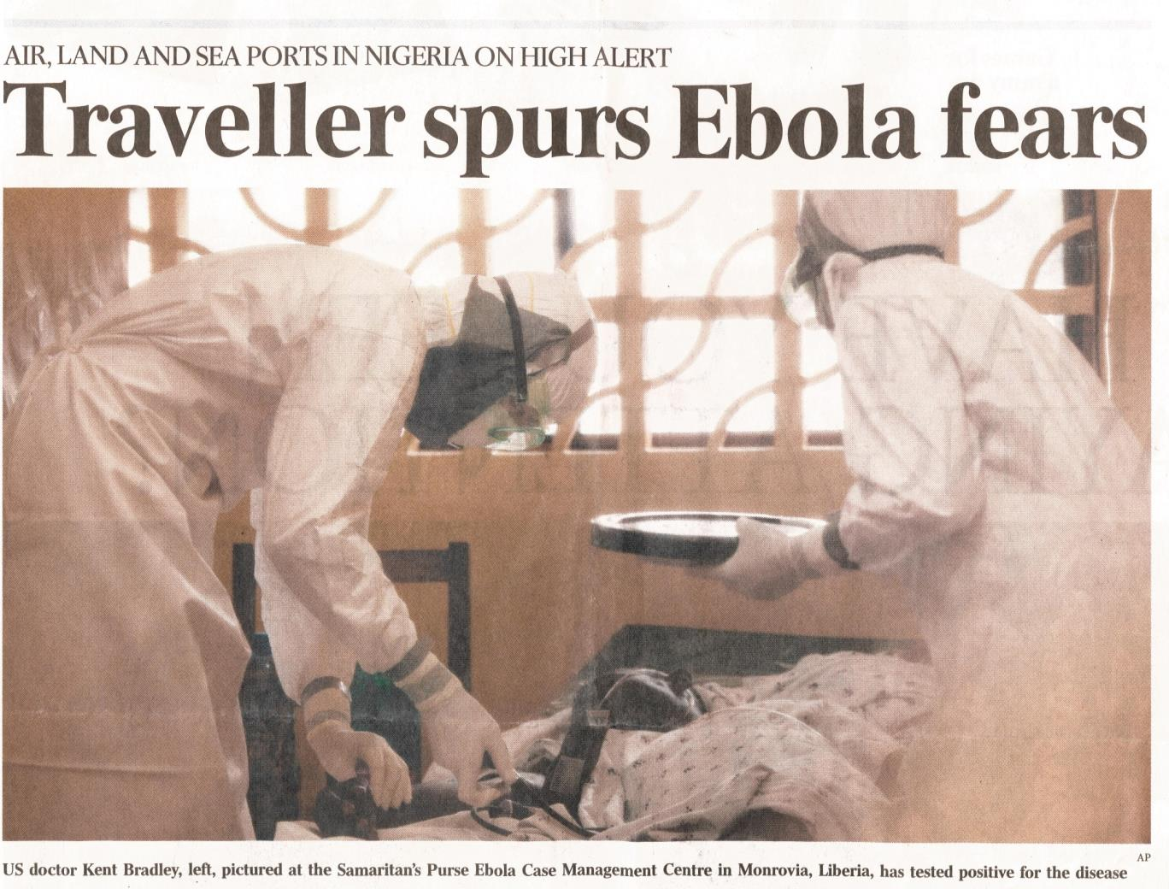
3 vaccines in phase I human trials in 2015
(cases in US citizens/hospitals!)

Slide 30

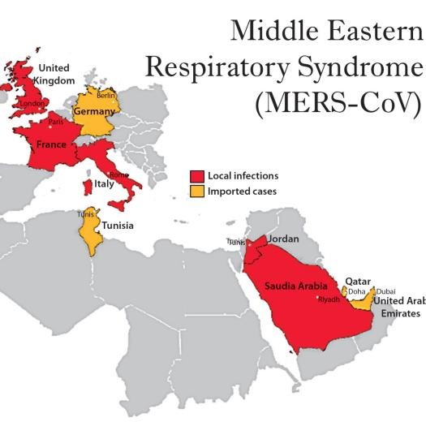
New Threats for Travellers
Currently there is NO vaccine
1st described Sept 2012
By June 2015: >1,200 lab-confirmed cases
>450 deaths ; CFR about 40%
Cases reside or traveller (or contact) in Middle East - >90% in Saudi
Surge in Feb/March in HCWs
100 + cases in S Korea June 2015
Importance of universal standard infection control plus transmission-based precautions when in contact with possible case

Slide 31
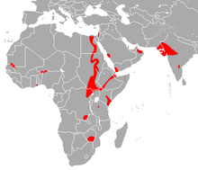
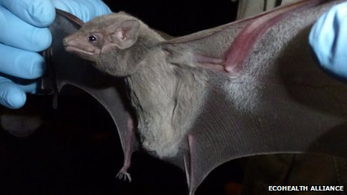
Egyptian tomb bat
Species of sac-winged bat
Sept 2013: isolation of MERS CoV

Slide 32
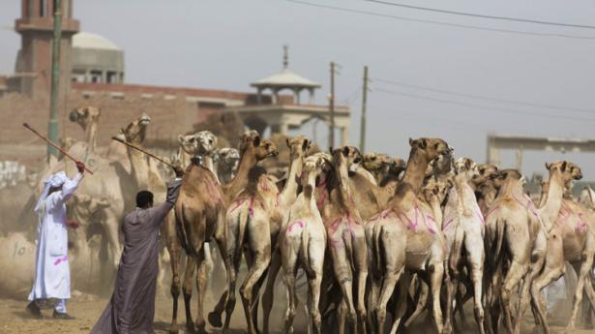
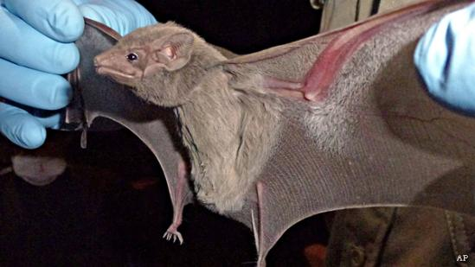
2013/4 -Antibodies against the MERS virus found in dromedary, ie one-humped camels
Antibodies were found in all 50 camel blood samples from Oman
Egyptian Tomb bat faeces revealed the virus; found close to where 1st MERS case reported

Slide 33
South Korea reports >100 MERS cases, June 2015
Most cases involve hospital transmission
An expert team from the World Health Organization (WHO) working with South Korean health officials to sift through the clinical, epidemiologic, and genetic features of the outbreak
"Given the travel history of the Korean index patient to other countries with recent MERS-CoV cases, the originating country cannot be determined with certainty,"

Slide 34
SUPER-TRANSMITTERS in Korean hospitals
Nearly 30 hospitals affected
A factor that may explain the outbreak's rapid expansion in South Korea is the practice of going to several hospitals following an initial diagnosis to get more medical opinions
Experts still aren’t certain why MERS-CoV seems to spread more easily in hospital settings:
The South Korean event generally resembles several hospital outbreaks seen in the Middle East, most notably one in Jeddah in 2014 that resulted in about 150 illnesses
Nearly 3,000 contacts are being followed, most of them in home isolation

Slide 35
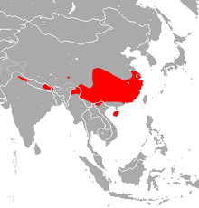
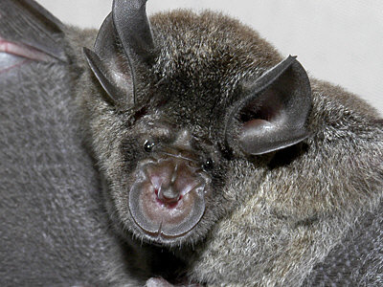
Chinese Horseshoe Bat

Slide 36
First Isolation and characterization of a bat SARS-like coronavirus NATURE Oct 31st 2013
First recorded isolation of a live SL-CoV (bat SL-CoV-WIV1) from bat faecal samples, typical coronavirus morphology, 99.9%sequence identity and uses ACE2 from humans, civets and Chinese horseshoe bats for cell entry
Intermediate hosts may not be necessary for direct human infection
Order : CHIROPTERA
Family : Rhinolophidae
Species : Rhinolophus lepidus refulgens
adapted to roost in man-made tunnels and drain culverts

Slide 37
SARS vaccines
Immunization with SARS Coronavirus vaccines may lead to pulmonary immunopathology in mice on challenge with the SARS virus
PLOS one 2012 Tseng et al
remember RSV
Correlates of protection still under investigation
Important roles remain for isolation and quarantine,
hand-washing, masks, gowns..

Slide 38
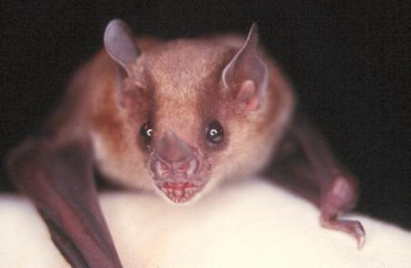
New World Bats: Diverse Influenza A Viruses
Tong, et al. PLoS Pathog 9(10). October 10, 2013
Aquatic birds harbor diverse influenza A viruses and are a major viral reservoir in nature
The recent discovery of influenza viruses of a new H17N10 subtype in Central American fruit bats suggests that other New World species may similarly carry divergent influenza viruses
Using consensus degenerate RT-PCR, a novel influenza A virus was identified, designated as H18N11, in a flat-faced fruit bat (Artibeus planirostris) from Peru
Serologic studies with the recombinant H18 protein indicated that several Peruvian bat species were infected by this virus
New World bats harbour more influenza virus genetic diversity than all other mammalian and avian species combined, indicative of a long-standing host-virus association
No evidence that humans can be infected

Slide 39
Scientists Closer to Universal Flu Vaccine
Those who avoid severe illness had more CD8 T cells, a type of virus-killing immune cell, in their blood at the start of the pandemic
A vaccine that stimulates the body to produce more of these cells could be effective at preventing flu viruses, including new strains that cross into humans from birds and pigs, from causing serious disease
"New strains of flu are continuously emerging, some of which are deadly, and so the Holy Grail is to create a universal vaccine that would be effective against all strains of flu"
Today's flu vaccines make the immune system produce antibodies that recognise structures on the surface of the virus to prevent infection with the most prevalent circulating strain - but usually one step behind due to having to be changed each year as new viruses with different surface structures evolve

Slide 40
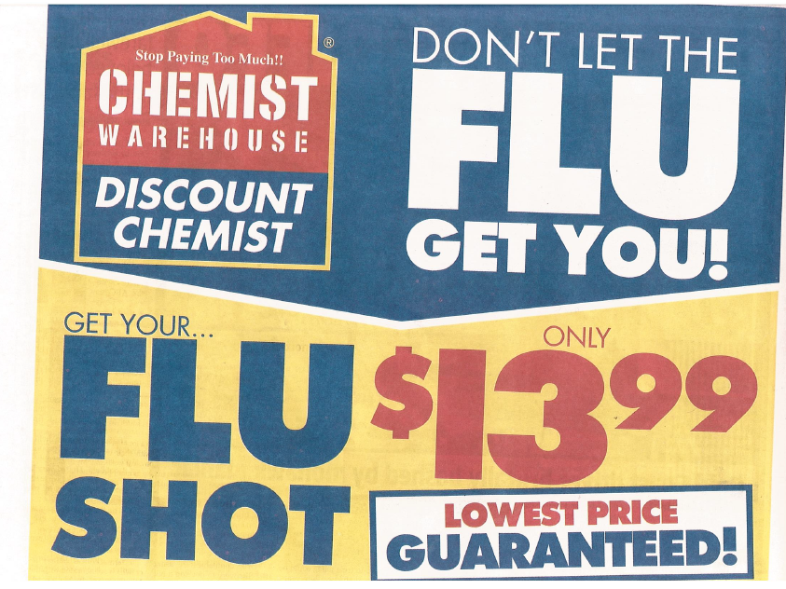

Slide 41
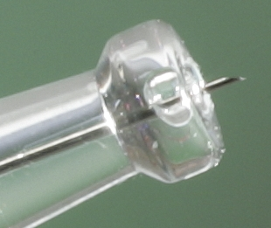
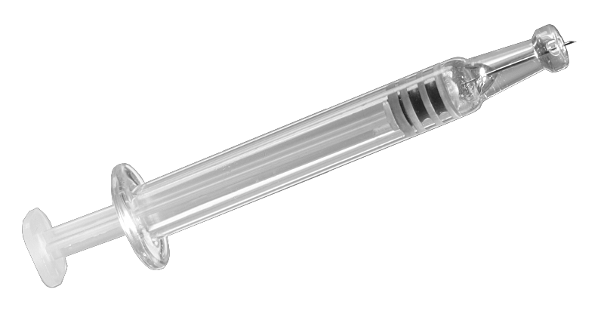
New Vaccine Delivery:
Intradermal Flu vaccine
Cutaneous flu vaccination by the intradermal route using easier and more reliable methods
“Intanza” Sanofi
Seasonal Influenza vaccine
9ug dose: 18-59 years
Private market
15ug dose:≥ 60 years
Micro Delivery System
Becton, Dickinson and Co.

Slide 42


Slide 43
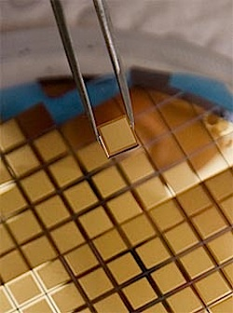
PATCHES to replace needles and syringes have moved a step closer to clinical trials
Health workers in PNG can handle the new technology, which may revolutionise vaccination in developing countries
Postage stamp-sized silicon wafers
Thousands of microscopic projections: dry-coated in vaccine (eg HPV)
The spikes deposit vaccine in skin which is rich in dendritic cells
Antigen-sparing and ?better AB responses
New trials in primates HPV vaccine

Slide 44
Who should be vaccinated?
HPV vaccine in National Immunisation Program (NIP): 3 doses routinely provided via school-based programs for girls and boys 12–13 years old
Catch-up vaccination was available for males aged 14–15 years in 2013 and 2014…
Those who receive vaccine prior to commencement of sexual activity gain most benefit
The National HPV Vaccination Program Register assists in ongoing monitoring and evaluation. All vaccination providers should report doses given to the Register.

Slide 45
Vaccines
Two HPV vaccines are available in Australia: the quadrivalent HPV vaccine, Gardasil®, which protects against four HPV types – 16, 18, 6 and 11; and the bivalent HPV vaccine, Cervarix®, which protects against 16 and 18
Gardasil: the only HPV vaccine registered in Australia for males
Both vaccines provide 90–100% protection against persistent infection and cervical/genital disease due to types 16 18 in females Gardasil® also provides > 85% protection against persistent genital infection and disease due to vaccine HPV types in males
Both Gardasil® and Cervarix® are safe and generally well tolerated
The most common side effect is a local reaction
Vaccination does not prevent infection from all HPV types Therefore, Pap tests remain an important preventive strategy against cervical cancer for women.

Slide 46
Could Single Doses Be the Future of HPV Vaccination?
One or two doses of the bivalent HPV vaccine appear as efficacious as the standard three-dose schedule in preventing cervical HPV type 16/18 infections, according to a post hoc analysis of data from two randomized trials Lancet Oncology June 2015
Four-year follow-up of the two studies combined showed that one-time detection of incident HPV 16/18 infection was reduced just as much after one or two doses as after three doses of the vaccine
Cross-protection against similar HPV types was not as strong with fewer than three doses, however

Slide 47
What vaccines should be prioritized in world terms?
Malaria
TB
HIV…

Slide 48
The origin of Tuberculosis
Nature Genetics Sept 2013 Sebastian Gagneux’s group
Africa, evolved with humans from >70,000 yrs ago
Evolutionary history reconstructed from genetics & geography
Predates domestication of animals 10,000 yrs ago neolithic demographic transition
when transmission &?virulence increased
NOW
2 billion latent infections; nearly 2 million deaths/year
MDR TB increasing the importance of (better) vaccines; on our doorstep; risk in refugees

Slide 49
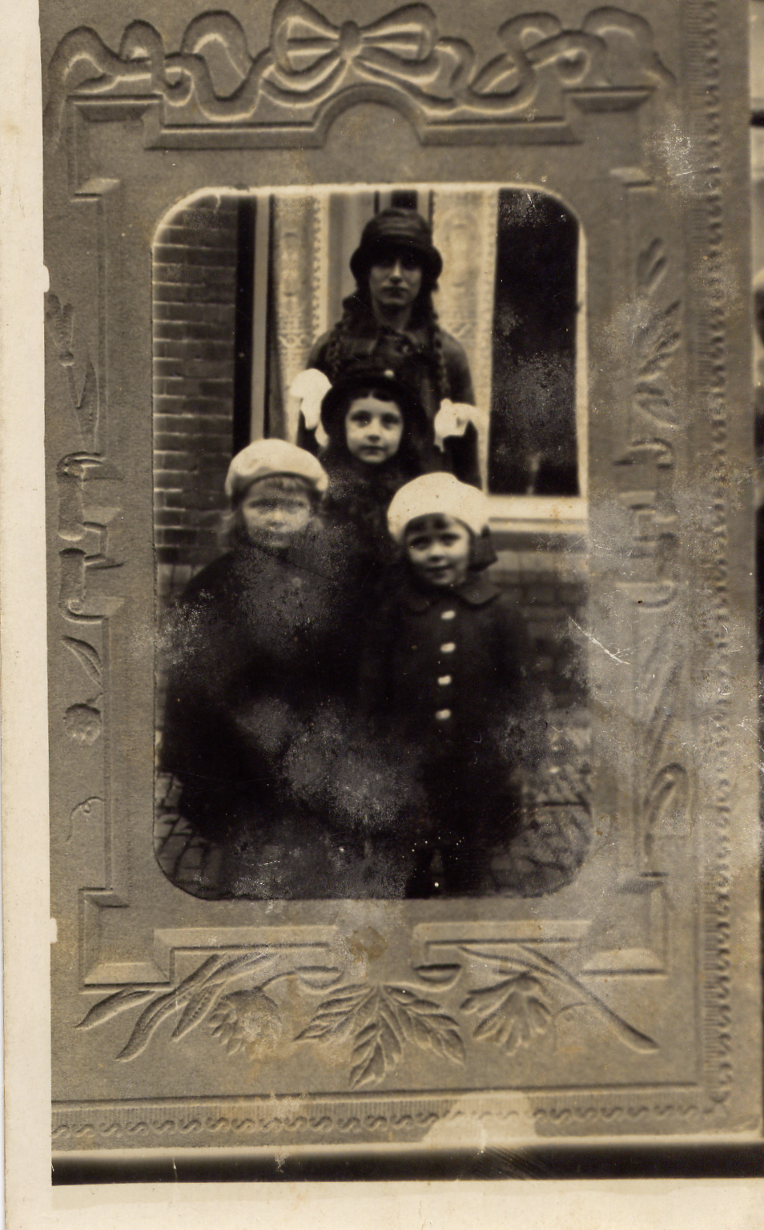
Current vaccine M bovis derived Bacillus Calmette-Guerin (BCG)
protects newborns: early miliary TB / meningitis
poorly effective in older children/adults

Slide 50
Malaria bad air, miasma
Malaria (plasmodium falciparum) also originated in Africa, but evolved before humans –
mosquitos in amber (50k yrs ago)
Origin: Gorillas Liu et al Nature 2010
Human P Falciparum forms monophyletic lineage within gorilla parasite radiation
Malaria vaccine development: >25 active candidates
GSK’s RTS, S in phase 3 development

Slide 51
HIV
Also originated in Africa
- Monkeys, not Gorillas
- Spilled over early 20th century in W Africa
4th biggest killer; >30 million cases alive now
Quite exciting news on vaccination!
Vaccination: the end of the beginning
Recent advances with humanised mice and in human efficacy trials: modest protection shown
  Cellular and humoral immune responses
  Broadly neutralising Abs can passively protect nonhuman primates
  - newly defined targets on HIV have been found..

Slide 52
Recent Vaccine successes: brain and other life-threatening infections
Haemophilus influenzae type b (Hib) one serotype
Meningococcus A C YW (B) serogroups
Pneumococcus 13 (or 23) of 92 serotypes

Slide 53
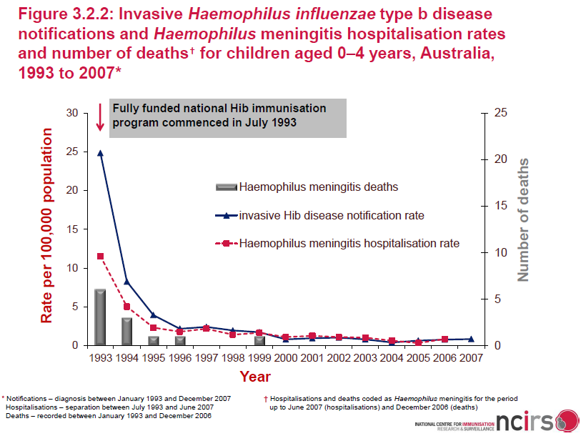
Hib conjugate vaccination has been very successful in reducing disease incidence
MEN-BEX-M-M-1027-2013-08-20
Notes:
1/Watt/
p S169/fig 4
3/Black/p 772/col 1/para 3; p 773/
fig 1; p774/
Table 2
2/Adams/
p222/col 1/
para 3,4
Key Point:
The use of conjugate vaccines has greatly impacted the incidence of Haemophilus influenzae type b (Hib) and Streptococcus pneumoniae disease.

Slide 54
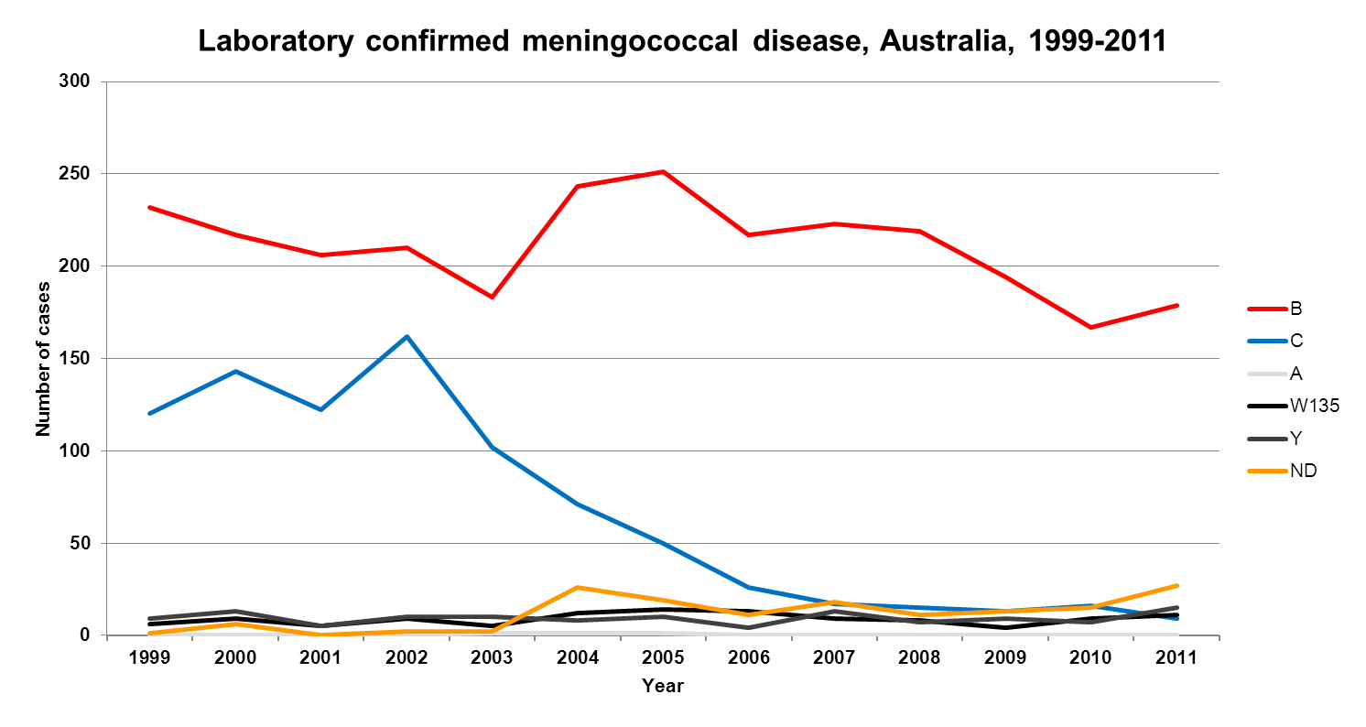
Successful introduction of MenC vaccination into Australia’s National Immunisation Program
MenC introduction onto NIP leading to a 94% reduction 2002 to 2011
Data source: Australian Meningococcal Surveillance program annual reports 1999-2011.
Communicable Diseases Intelligence. 162 MenC cases in 2002 and 9 MenC cases in 2011
MEN-BEX-M-M-1027-2013-08-20

Slide 55
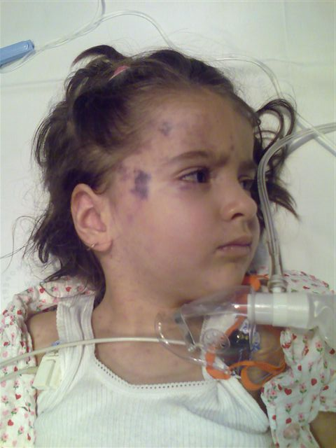

Slide 56
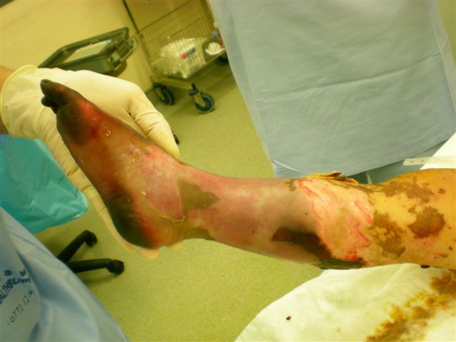

Slide 57
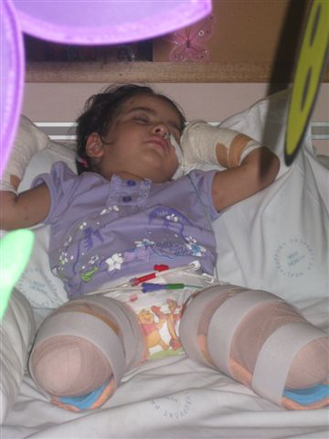

Slide 58
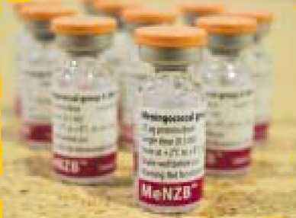
Meningococcal B vaccines
Novartis/Chiron MeNZB™ licensed in New Zealand, 2004
Previously highly strain specific
  outbreaks (NZ, Cuba, Norway)
Need antigens conserved in most prevalent types
Need to immunise early in infancy (disease epi)
2 vaccine candidates
  4 component
  Human factor H binding protein
  Clinical trials successful 4 component BEXSERO vaccine

Slide 59

New Men B vaccine licensed in Australia
Today: Happy but happier if she had been vaccinated
Will the vaccine be recommended for routine use?

Slide 60
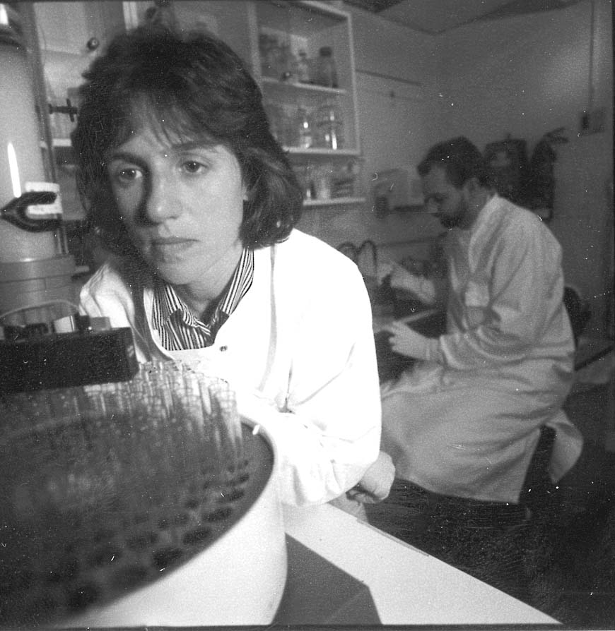
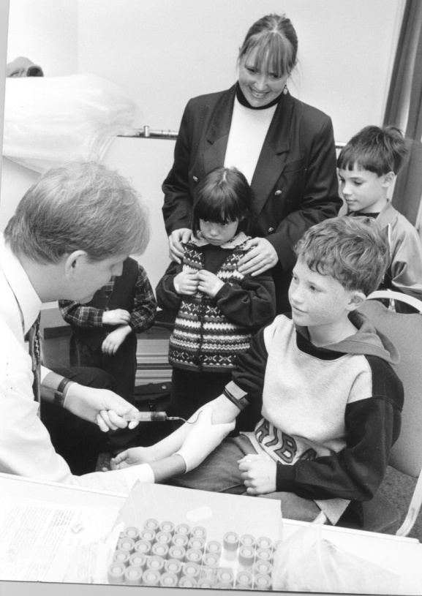
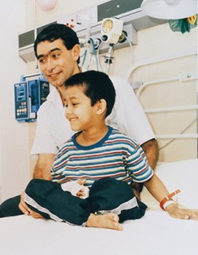

Slide 61
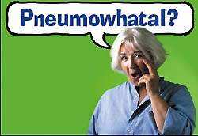

Slide 62
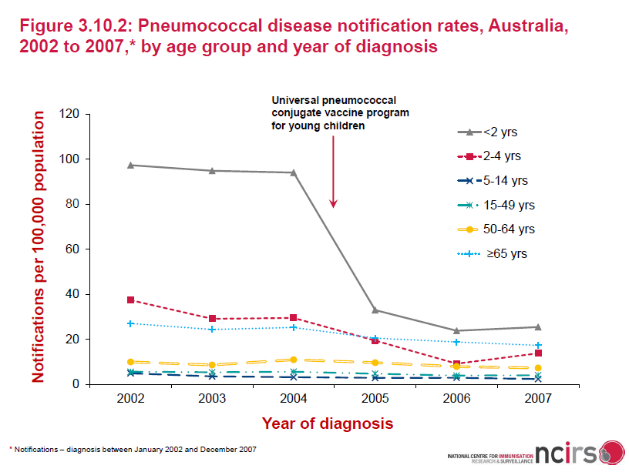
PCV7 vaccination programmes have been very successful in reducing disease incidence
MEN-BEX-M-M-1027-2013-08-20
Notes:
1/Watt/
p S169/fig 4
3/Black/p 772/col 1/para 3; p 773/
fig 1; p774/
Table 2
2/Adams/
p222/col 1/
para 3,4
Key Point:
The use of conjugate vaccines has greatly impacted the incidence of Haemophilus influenzae type b (Hib) and Streptococcus pneumoniae disease.

Slide 63
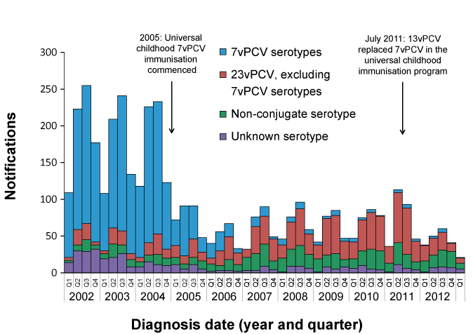
Notified cases of IPD aged less than 5 years, Australia, 2002 to the first quarter of 2013, by serotypes*

Slide 64
The growth of global immunisation WHO data
Immunisation has been one of the great success stories of global health
Prevents the deaths of 2 - 3 million children each year
But another 1.5 million children still die from vaccine preventable diseases
Smallpox eradication in 1979 helped encourage global efforts to fight more diseases through immunisation
Maps on following slides chart the growth of global vaccine coverage from 1980 and show which countries are doing best - and worst

Slide 65
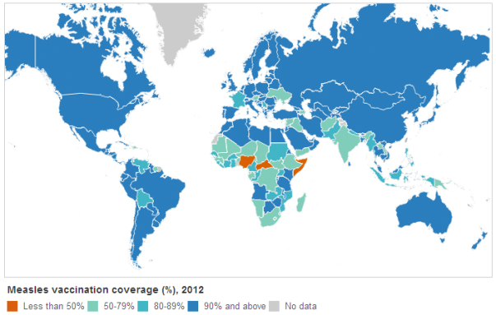
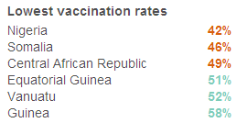
Measles
Very effective vaccine introduced in late 1960s and uptake soared from 1980
Deaths have plummeted from 2.6 million in 1980 to <150,000 in 2012

Slide 66
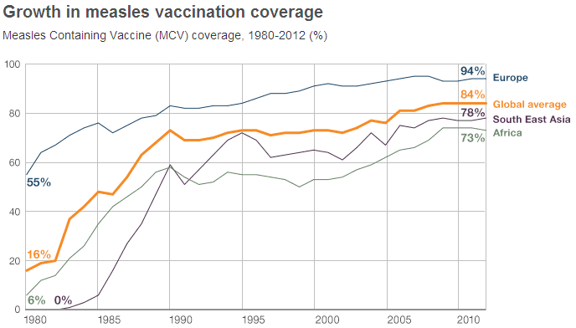
The long view
Concern that global immunisation rates have levelled off in recent years
By 2012, 84% of children globally got one dose of measles vaccine by their second birthday
Since 2009 the WHO has recommended that all children receive a second dose of the vaccine
Since measles only affects humans it should be possible to eradicate but several targets have been missed Western Pacific doing well..

Slide 67
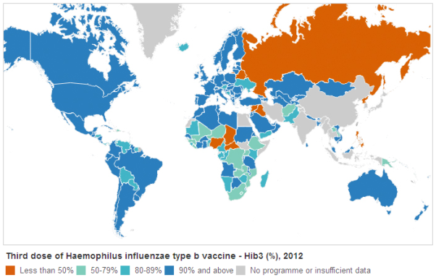
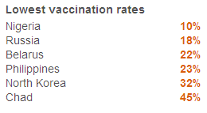
Hib
Haemophilus influenzae type b (Hib) is a bacterial infection which causes severe pneumonia epiglottitis and meningitis, especially in young children
virtually eliminated in developed countries
More than two decades after an effective vaccine was introduced, half the world’s children are still not getting all three doses…

Slide 68
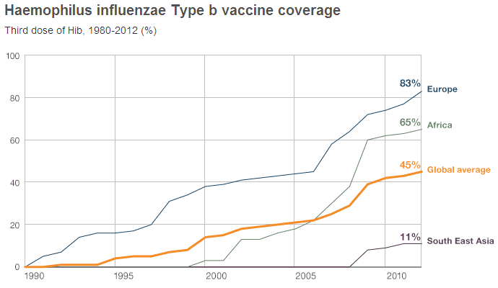
The long view
The first Hib vaccine was licensed in 1985
Steady increase in vaccine coverage among wealthy countries, but low income countries have lagged behind
In 2000, Hib estimated to cause 386,000 deaths worldwide in Kids <5 yrs
A major health initiative has led to a dramatic increase in coverage in poorer nations - especially across Africa - but coverage in SE Asia remains poor

Slide 69
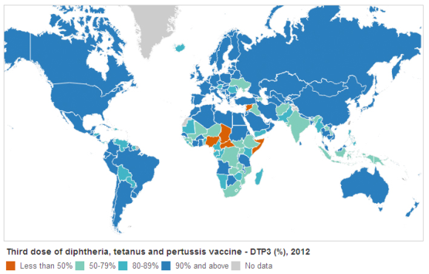

DTP
DTP is a combined vaccine against diphtheria, tetanus and pertussis
Pertussis remains a major cause of infant death
In 2008 it caused around 195,000 fatalities
Tetanus >500,000 infant deaths in 1980, but the death rate has since declined
Diphtheria is rare except in poorer nations
Proportion of children receiving all three doses is a key indicator of global coverage

Slide 70

The long view
Currently, more than 100 million children get fully immunised against DTP every year, but 20 million do not get the full three doses
The one in five children who miss out are almost all among the poorest families from poorer nations
Weak healthcare systems and difficulties reaching remote areas and storing the vaccines at the correct temperature are pressing issues in many countries

Slide 71


Summary of Impact
Overview, web views, distribution & ROI
October 2013

Slide 72

Chain of Protection
Launched in June 2010
Made possible through an unrestricted education grant from Medicine Australia
Purpose: provide families & health professionals a way to understand immunisation
  To be engaged emotionally via video, asked to take action by learning more, acting on what’s learnt and to care for those around them by asking them to be immunised
Two main feature films plus 17 shorts produced

