Slide 1
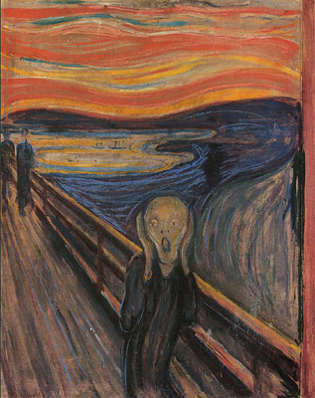
Is it depression or is it bipolar disorder?
“Manic depression is a frustrating mess”
Manic Depression, Jimi Hendrix
Jon-Paul Khoo

Slide 2
Depression
50-80% of all depression management occurs in primary care
One of the most common conditions in primary care
  Nearly 10% of all primary care presentations are depression related
Lifetime prevalence of depression is 1 in 7 (10-15%)
12 month prevalence of depression is 6.2%
  Unipolar depressive episodes 4.1%
  Dysthymia 1.3%
  Bipolar disorder 1.8%
  Using these figures, of depressed people, 29% will have bipolar disorder

Slide 3
Missing bipolar disorder diagnosis
2/3 bipolar disorder patients are misdiagnosed
  An average of 3.5 times
  By 4 different doctors
  1/3 are symptomatic for 10 years before diagnosis
  6-7.5 years between misdiagnosis and accurate diagnosis
Up to about 40% of bipolar inpatients/ outpatients initially diagnosed with MDD

Slide 4
Bipolar disorder
Under-recognised and under-diagnosed
Incorrectly diagnosed as
unipolar depression
31.2%
No diagnosis
49.0%
19.8%
Correctly diagnosed
with bipolar disorder
Mood Disorder Questionnaire-Positive Rates (US population)
n=85,358
Hirschfeld 2003. J Clin Psychiatry 2003; 64: 53-59.
Notes:
Bipolar disorder: unrecognised and undiagnosed
Hirschfeld and colleagues conducted a study to estimate the rate of positive screens for bipolar I and II disorder in the general population of the USA.
The Mood Disorder Questionnaire, which is a validated screening tool for bipolar I and II, was sent to 127,800 people (aged ≥18 years) in the USA. Overall 66.8% of people responded (n=85,358).
Of the people with a positive screen for bipolar disorder, 19.8% reported that they had previously received a diagnosis of bipolar disorder from a physician; 31.2% of those screened positive for bipolar disorder reported a physician diagnosis of unipolar depression. 49.0% reported no diagnosis of either bipolar disorder or unipolar depression.
Reference
Hirschfeld RM et al. Screening for bipolar disorder in the community.

Slide 5
Bipolar disorder in primary care
Primary care screens
  ~8-10% bipolar disorder
  0.5-4.3% bipolar disorder using structured psychiatric interviews
  An example using MDQ (Das, JAMA 2005;293:956-963)
    9.8% prevalence bipolar disorder on screen
    49% doctor noted current evidence of depression
    72.3% had sought professional assistance
    8.4% diagnosed
    6.5% on a mood stabiliser
    44% on other agents

Slide 6
Bipolar disorder
Lifetime prevalence 1.4-6.4%
Chronic, recurrent and irregular course
  Acute episodes are a relatively small part of the overall illness
  High frequency of subsyndromal interepisode symptoms
Heavy comorbidity
Life impact similar to multiple sclerosis, and > end-stage renal disease or rheumatoid arthritis
35% attempt suicide and lifetime risk of death by suicide up to 19% (similar to heart disease and cancer)
  SMR suicide M2.5 F2.7 = SMRs for cardiovascular deaths
Mortality from all causes is greater if untreated

Slide 7
DSM-5 Manic episode
1 week (or any duration if hospitalised)
Abnormally and persistently
  Elevated, expansive, or irritable mood and
  Increased goal-directed activity or energy
3 or more of the following symptoms (4 if irritable only):
  Inflated self-esteem or grandiosity
  Decreased need for sleep
  Increased or pressured speech
  Flight of ideas/racing thoughts
  Distractibility
  Increased goal-directed activity or PMA
  Risk-taking behaviour
Severe enough to cause marked impairment, hospitalisation and/or psychotic features
Exclusions

Slide 8
DSM-5 Hypomanic episode
4 days
Abnormally and persistently
  Elevated, expansive, or irritable mood and
  Increased goal-directed activity or energy
3 or more of the following symptoms (4 if irritable only):
  Inflated self-esteem or grandiosity
  Decreased need for sleep
  Increased or pressured speech
  Flight of ideas/racing thoughts
  Distractibility
  Increased goal-directed activity or PMA
  Risk-taking behaviour
Change in functioning; uncharacteristic; observable: but NOT severe enough to cause marked impairment functioning or hospitalisation
Exclusions

Slide 9
DSM-5 Bipolar and related disorders
Bipolar I disorder
Bipolar II disorder
Cyclothymic disorder
Substance/medication-induced bipolar and related disorder
Bipolar and related disorder due to another medical condition
Other specified and related bipolar disorders
  History of MDD and subthreshold duration for hypomania
  History of MDD and subthreshold number of criteria
  Hypomanic episode without MDD
  Short duration cyclothymia
Specifiers
  Rapid-cycling/with anxious distress/with mixed features

Slide 10
DSM-5 Bipolar and related disorders
Mania with psychosis
Mania
Hypomania
Subsyndromal elevation
Normal mood
Subsyndromal depression
Mild depression
Moderate depression
Severe depression
Severe depression with psychosis
Cyclothymia
Other specified and related bipolar disorders
Major Depressive Disorder
Bipolar II Disorder
Bipolar I Disorder

Slide 11
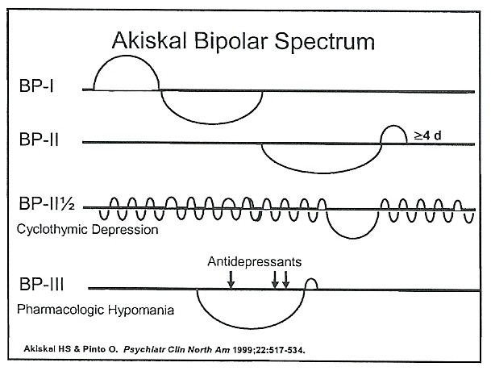
Akiskal’s Bipolar Spectrum

Slide 12
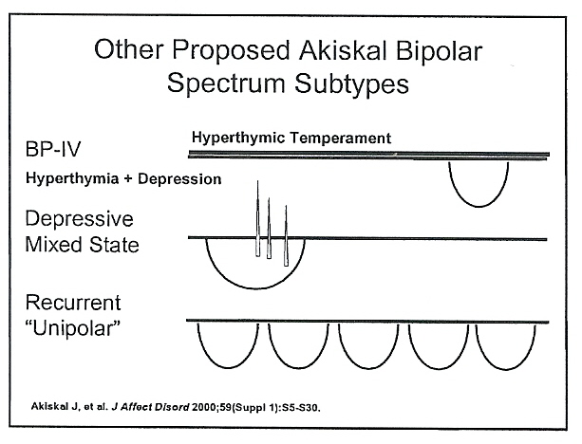
Akiskal’s Bipolar Spectrum

Slide 13
Causes of misdiagnosis as depression
Overly restrictive DSM criteria
Critical diagnostic element is elevation
  But bipolar disorder is depression-predominant
  Most bipolar patients seek treatment only for depression
Elevation usually absent at time of diagnosis
  Diagnosis often based on history rather than presentation
Historical mania and hypomania are missed
  Not asked after, denied or not spontaneously reported
    Insight impairment is common
    Hypomania may be subtle or constructive
    Feel good, creative, active, heightened well-being, energised, productive, social, invigorated
      Not considered negative or even preferred
  Non-classical phenomena are common
  Often no historical indication/record of hypomania

Slide 14
Frequency of symptoms
Bipolar I disorderª
Bipolar II disorder^{b}
5.9%
1.3%
2.3%
9.3%
52.7%
50.3%
46.1%
31.9%
Time asymptomatic
Time manic / hypomanic
Time depressed
Time cycling / mixed
Irrespective of bipolar subtype, patients spend the majority of their time in the depressed state
n=146, bipolar I; n=86, bipolar II
Follow up: ª12.8 years; ^{b}13.4 years
Judd et al 2002; 2003
Notes:
Frequency of symptoms
In a study of long-term symptomatic status by Judd et al, patients with bipolar I disorder patients (12.8 years follow up) experienced 3 times more depressive symptoms (31.9% of total follow-up weeks) than manic symptoms (9.3% of weeks), and depressive symptoms were 5 times more frequent than cycling/mixed symptoms (5.9% of weeks).
In a similar study by Judd et al, patients with bipolar II disorder were symptomatic for 53.9% of weeks during a 13.4 year follow-up period. Again depressive symptoms dominated over hypomanic and mixed/cycling. Depressive symptoms occurred for 50.3% of weeks, hypomanic symptoms occurred for 1.3% of weeks and cycling/mixed symptoms occurred during 2.3% of weeks.
References
Judd LL et al. The long-term natural history of the weekly symptomatic status of bipolar I disorder. Arch Gen Psychiatry 2002; 59: 530-537.
Judd LL et al. A prospective investigation of the natural history of the long-term weekly symptomatic status of bipolar II disorder. Arch Gen Psychiatry 2003; 60: 261-269.

Slide 15
Onset timeline of Bipolar Disorder
Mood swings & symptoms of depression (18.0)
Full episode of depression (21.1)
Diagnosis of bipolar disorder (30.0)
Full episode of mania (24.3)
Symptoms of mania (21.3)
15
20
Medical treatment (24)
25
30
Any symptoms of mental illness (17.5)
Age (Median)
Berk 2007, Journal of Affective Disorders

Slide 16
Consequences of misdiagnosis as depression
Inappropriate monotherapy with antidepressants
  “Treatment resistant depression” which is really pseudo-resistance
  May destabilise the illness
Delays appropriate treatment
  Increases recurrence, chronicity and suffering
Worsens occupational, family, social and economic disadvantage
Increased healthcare costs
Increased suicide attempts

Slide 17
Burden of disease across disorders averted with optimal treatment
Burden of
disease
(YLD)
[%]
Bipolar
disorder
GAD
PTSD
Dysthymia
Harmful use
of alcohol
Depression
Social phobia
Alcohol
dependence
Schizophrenia
Panic disorder /
agoraphobia
YLD, Years lived with disability
Andrews et al 2004

Slide 18
Is the depression bipolar?
A practical approach to mitigating bipolar misdiagnosis

Slide 19
Is the depression bipolar?
Index of suspicion and a probabilistic approach

Slide 20
A probabilistic approach
No pathognomonic characteristics of bipolar depression compared to major (unipolar) depressive disorder
  Maintain a high index of suspicion
  Consider bipolar disorder in every depressive presentation
There are clinical, illness and historical characteristics more commonly associated with bipolar depression
Use a probabilistic (or likelihood) approach to consider the differential likelihood of bipolar or unipolar depression
Mitchell PB et al. Bipolar Disorders 2008;10:144–152.

Slide 21
Is the depression bipolar?
Index of suspicion and a probabilistic approach
History
  Personal history of mania/hypomania

Slide 22
  History of mania/hypomania
Duration?
Abnormally and persistently
  Elevated, expansive, or irritable mood and
  Increased goal-directed activity or energy
3 or more of the following symptoms (4 if irritable only):
  Inflated self-esteem or grandiosity
  Decreased need for sleep
  Increased or pressured speech
  Flight of ideas/racing thoughts
  Distractibility
  Increased goal-directed activity or PMA
  Risk-taking behaviour
Severity of impairment, hospitalisation and/or psychotic features
Exclusions

Slide 23
Is the depression bipolar?
Know about bipolar disorder
Index of suspicion and a probabilistic approach
History
  Personal history of mania/hypomania
  Family history of bipolar disorder

Slide 24
Bipolar family history markers
Consecutive generation mood disorder
  Genetic anticipation
Completed suicide
Mood stabiliser usage
Alcohol/substance use disorder
Institutionalisation
?Eccentricity
Clustered comorbid associations of bipolar disorder
  Depression, anxiety, substance, gambling, ADHD, eating disorder

Slide 25
Is the depression bipolar?
Know about bipolar disorder
Index of suspicion and a probabilistic approach
History
  Personal history of mania/hypomania
  Family history of bipolar disorder
  Comorbidity

Slide 26
Comorbidity
Comorbidity is the norm (60-70%)
  Psychiatric
    Anxiety disorder; personality disorder; eating disorder; ADHD; impulse control disorders
  Substance use disorder
  Medical disorder
    Migraine; MS; Cushing's syndrome; CNS neoplasm; head trauma; asthma; obesity; T2DM; CVD; metabolic syndrome; thyroid disorder
Clustering raises suspicion
May alter presentation
May dominate presentation
May influence physician diagnostic response

Slide 27
Is the depression bipolar?
Know about bipolar disorder
Index of suspicion and a probabilistic approach
History
  Personal history of mania/hypomania
  Family history of bipolar disorder
  Comorbidity
  Look for bipolar markers in illness course

Slide 28
Markers for bipolarity in illness course
Onset
  Postpartum
  Early age (<25years)
  More equal gender ratio
Past illness history
  High number of prior depressive episodes
  Frank elevation (nb mixed presentations)
  Sudden onset/offset (“abruptness” and shorter episodes)
  Seasonal mood variations (winter depressions)
  History of recurrent but brief depressive episodes
Treatment history
  Response to mood-stabilisers
  Adverse reactions to antidepressants

Slide 29
Is the depression bipolar?
Know about bipolar disorder
Index of suspicion and a probabilistic approach
History
  Personal history of mania/hypomania
  Family history of bipolar disorder
  Comorbidity
  Look for bipolar markers in illness course
  Adverse reactions to antidepressants

Slide 30
Adverse reactions to antidepressants
Antidepressant-induced mood disturbances
  Gross activation
  Elevation (mania/hypomania)
  Induction of mixed states
  Cycle destabilisation/acceleration (rapid-cycling)
Atypical reactions
  Antidepressant inefficacy
  Antidepressant “tolerance”/“Poop-out”
  On-off phenomena

Slide 31
Is the depression bipolar?
Know about bipolar disorder
Index of suspicion and a probabilistic approach
History
  Personal history of mania/hypomania
  Family history of bipolar disorder
  Comorbidity
  Look for bipolar markers in illness course
  Adverse reactions to antidepressants
Look for bipolar markers on examination

Slide 32
Phenomenological markers for bipolarity on mental state examination:
Atypical features
  Hypersomnia, leaden paralysis, hyperphagia and weight gain
Irritability and other mixed features
  DSM-5 MDE with mixed features
Greater suicidality
Catatonia and/or psychotic features (pathological guilt)
Lability of mood
Flatness/emotionlessness rather than sadness/crying
More melancholic features
  Psychomotor retardation, severe anhedonia, EMW and DMV
Greater probability of substance abuse
More anxiety
Anger attacks
Fewer physical complaints

Slide 33
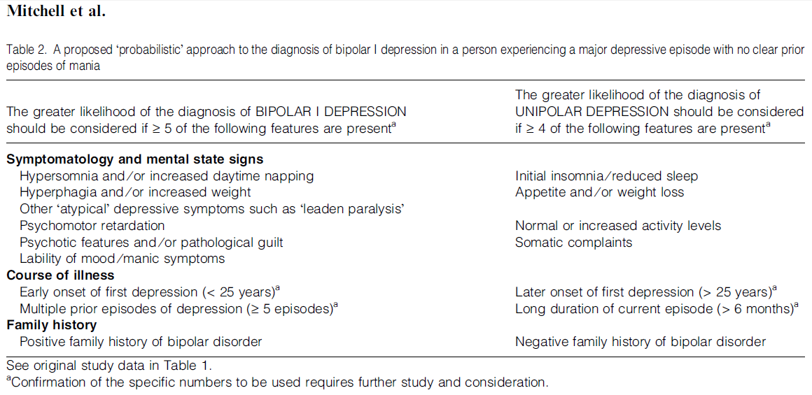
A probabilistic approach
Mitchell PB et al. Bipolar Disorders 2008: 10: 144–152.

Slide 34
Is the depression bipolar?
Know about bipolar disorder
Index of suspicion and a probabilistic approach
History
  Personal history of mania/hypomania
  Family history of bipolar disorder
  Comorbidity
  Look for bipolar markers in illness course
  Adverse reactions to antidepressants
Look for bipolar markers on examination
Use bipolar symptom screening instrument

Slide 35
Bipolar symptom screening instruments
Mood Disorder Questionnaire

Slide 36
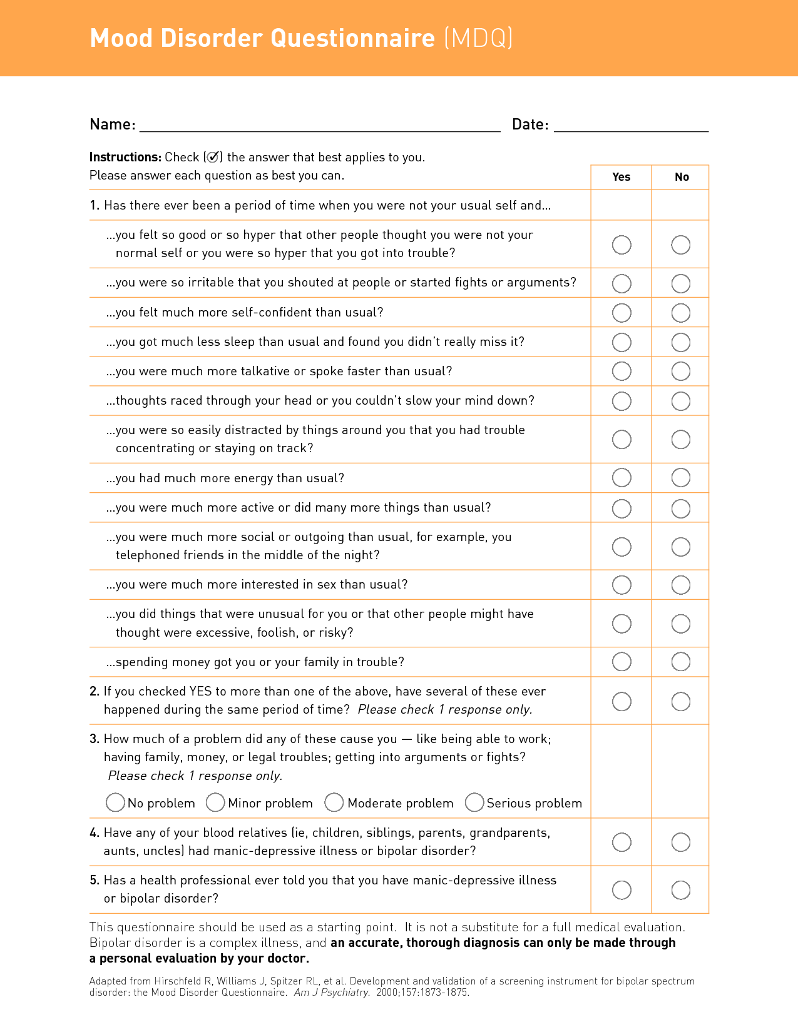
≥ 7/13 items
Concurrence
≥ Moderate impact
Family history
Previous diagnosis

Slide 37
Bipolar symptom screening instruments
Mood Disorder Questionnaire
Black Dog Institute
  Bipolar Self-test (Mood Swings Questionnaire)

Slide 38
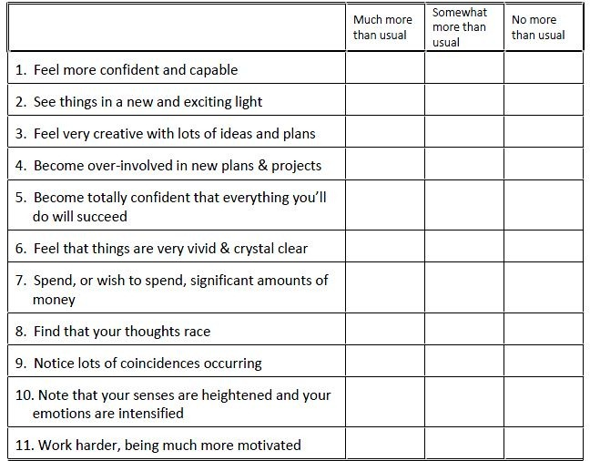
Black Dog Bipolar Self-test part 1

Slide 39
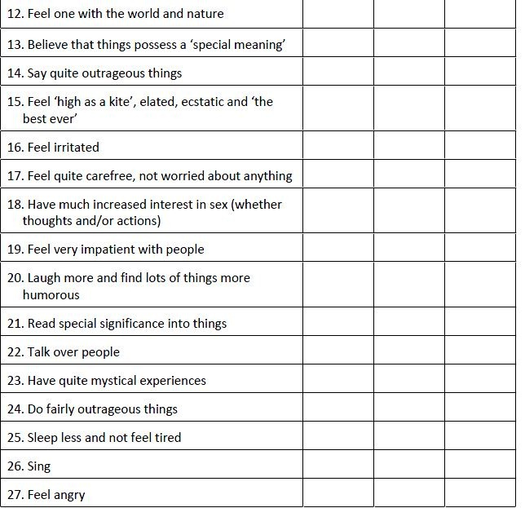
Black Dog Bipolar Self-test part 2

Slide 40
Bipolar symptom screening instruments
Mood Disorder Questionnaire
Black Dog Institute
  Bipolar Self-test (Mood Swings Questionnaire)
  Mood Assessment Program (MAP)

Slide 41



Slide 42
Bipolar symptom screening instruments
Mood Disorder Questionnaire
Black Dog Institute
  Bipolar Self-test (Mood Swings Questionnaire)
  Mood Assessment Program (MAP)
Hypomania Checklist (HCL 32)

Slide 43
Bipolar symptom screening instruments
Mood Disorder Questionnaire
Black Dog Institute
  Bipolar Self-test (Mood Swings Questionnaire)
  Mood Assessment Program (MAP)
Hypomania Checklist (HCL 32)
The Bipolarity Index

Slide 44
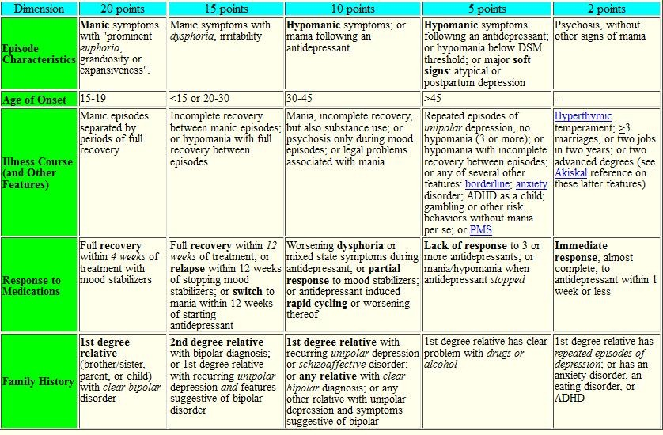
Bipolarity Index

Slide 45
Is the depression bipolar?
Know about bipolar disorder
Index of suspicion and a probabilistic approach
History
  Personal history of mania/hypomania
  Family history of bipolar disorder
  Comorbidity
  Look for bipolar markers in illness course
  Adverse reactions to antidepressants
Look for bipolar markers on examination
Use bipolar symptom screening instrument
Involve significant other(s) in assessment

Slide 46
Is the depression bipolar?
Know about bipolar disorder
Index of suspicion and a probabilistic approach
History
  Personal history of mania/hypomania
  Family history of bipolar disorder
  Comorbid associations
  Look for bipolar markers in illness course
  Adverse reactions to antidepressants
Look for bipolar markers on examination
Use bipolar symptom screening instrument
Involve significant other(s) in assessment
Refer for specialist consultation

Slide 47
Summary and conclusions
Depressive presentations are common
Not all depression is MDD
Bipolar disorder is a more severe disorder that requires different and more complicated treatments
Bipolar disorder is commonly misdiagnosed as MDD for reasons relating to nosological, illness, patient and physician factors
Correctly diagnosing bipolar disorder ensures appropriate treatment and reduces patient adversity

Slide 48
Summary and conclusions
You can mitigate bipolar disorder misdiagnosis in your practice tomorrow by
  Understanding, suspicion and a probabilistic approach
  Asking after previous elevation, family history and comorbidity
  Looking for bipolar markers in illness course, treatment history and mental state psychopathology
  Using a bipolar symptom screening instrument
  Involving significant others in assessment

