Slide 1
Oral Therapy for Iron Deficiency - Tips, Traps and Special Situations
Dr Renee Eslick
Haematologist / Obstetric Physician

Slide 2
Disclosures for Renee Eslick
Speaker fees for Bristol Myers Squibb, Pfizer and Viatris

Slide 3
Key Lessons
The importance of proactively identifying at-risk groups and intervening with early iron replacement, including in pregnancy, menstruating teenagers, and vegetarians/vegans
Considering and excluding alternative causes of iron deficiency in women of childbearing age
Tips for patients to maximise iron absorption, including foods / supplements to avoid when taking oral iron
Second daily iron dosing

Slide 4
Trap #1 – Why Should We Care?
“Iron deficiency isn’t really all that important.”

Slide 5
Frequency of Iron Deficiency Anaemia
Cohort of 300 healthy women attending a UK fitness show
Mean age 31.2
12% were anaemic
Cohort of 271 women undertaking 5km, 10km or half-marathon in Singapore
Mean age 36.3
18.8% anaemic, 48% iron deficient
Cohort of 272 female nurses attending a conference
Mean age 40.1
13.2% were anaemic, 35% iron deficient
Dugan et al. The misogyny of iron deficiency. Anaesthesia 2021, 76: 56-62

Slide 6
Men vs Women
Ahmed et al. Iron status among Australian adults: findings of a population based study in Queensland, Australia. Asia Pac J Clin Nutr 2008; 17(1): 40-47

Slide 8
Symptoms
Fatigue, exhaustion
Reduced cognitive function
Muscle weakness
Exertional dyspnoea
“I just thought it was normal to feel like this”
Dugan et al. The misogyny of iron deficiency. Anaesthesia 2021, 76: 56-62

Slide 9
Consequences of Iron Deficiency Anaemia
Exacerbation of heart failure or ischaemic heart disease
Increased risk of postoperative morbidity and mortality
Linked with low birth weight, preterm delivery, neonatal morbidity
ASH Image Bank

Slide 10
Solutions
Ask younger female patients about symptoms of iron deficiency and heavy menstrual bleeding
Consider proactively screening at-risk groups:
Vegetarian / vegan diet
Self-reported heavy menstrual bleeding
Closely spaced pregnancies

Slide 11
Trap #2
“Iron deficiency anaemia in younger women is always due to menstrual losses.”

Slide 12
Premenopausal Women
Iron deficiency in younger women is usually due to combination of menstrual losses, pregnancy, and inadequate dietary intake
Age | RDI
Boys aged 14-18 | 11mg per day
Girls aged 14-18 | 15mg per day
Males 19+ | 8mg per day
Females 19+ | 18mg per day
Pregnant women | 27mg per day
Nutrition Australia, 2014

Slide 13
Nutrition Australia, 2014
Notes:
Haem iron absorption: 25% absorption on average; up to 40% when iron deficient and down to 15% when iron replete
Non haem iron absorption: 5-15%, significant variability

Slide 14
Consider Alternative Causes
Up to 5% of patients with iron deficiency anaemia (IDA) have coeliac disease
Heavy menstrual bleeding – 20% of these women have an underlying bleeding disorder
Consider underlying gynaecological pathology
Can use ‘IDIOM’ app to quantify bowel cancer risk (rare in younger women):
https://www.predict-gi-risk-in-ida.com/ver1.0/2020/

Slide 15
“At every moment in our lives, we all have one foot in a fairy tale and the other in the abyss.”
Paulo Coehlo

Slide 16
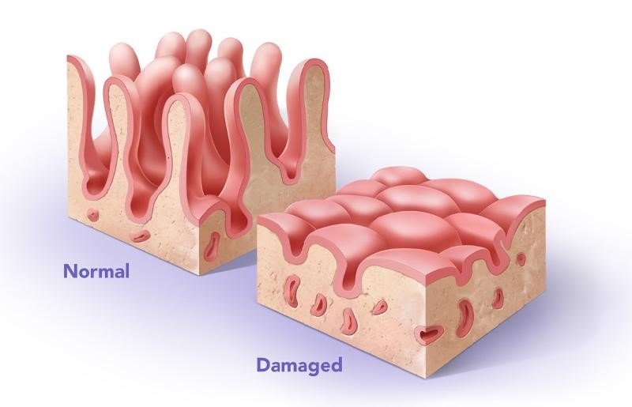
Causes of Iron Deficiency
Inadequate intake
Diet
Malabsorption
Coeliac disease
Obesity surgery
H pylori infection
Rare inherited conditions
Notes:
Iron absorbed in the duodenum / jejunum

Slide 17
Causes of Iron Deficiency
Increased losses
Menstrual
Gastrointestinal
Blood donation
Haemorrhage
Exercise
Pregnancy
INCREASED DEMAND

Slide 18
Tests to Consider
In ALL WOMEN
IN SELECTED WOMEN
Coeliac serology
Urinalysis
Bleeding disorder screening:
von Willebrand antigen, activity, ristocetin cofactor (RiCOF), collagen binding assay (CBA), FVIII
PT/APTT
Fibrinogen
Endoscopy
Snook et al. British Society of Gastroenterology guidelines for the management of iron deficiency anaemia in adults. Gut 2021;70:2030-2051

Slide 19
Endoscopy for Premenopausal Women
GESA guidelines: “age over 50”
British Society of Gastroenterology:
Age >50
Red flag symptoms
Strong family history bowel cancer (two first-degree relatives, or one first-degree relative under the age of 50)
Recurrent severe iron deficiency, disproportionate to menstrual losses
Snook et al. British Society of Gastroenterology guidelines for the management of iron deficiency anaemia in adults. Gut 2021;70:2030-2051

Slide 20
Trap #3
“If I tell my patient to start iron supplements, their iron stores will improve.”

Slide 21
Oral Iron Supplements
Not all iron supplements are created equal…
Of >100 iron containing supplements in Australia, majority contain insufficient iron for the treatment of iron deficiency anaemia
Important to specify what supplement, and how often

Slide 22
Patient Information Booklets
Oral Iron Choices for Adults. Australian Red Cross Lifeblood 2020

Slide 23
Iron Product Choice and Dose Calculation for Adults. National Blood Authority 2016

Slide 24
What Formulation?
Iron Supplement
Bivalent (Fe²⁺) Ferrous fumurate Ferrous gluconate Ferrous sulfate Ferrous glycine sulfate
Trivalent (Fe³⁺) Iron polymaltose complex Iron protein succinylate
Gulec S et al. Mechanistic and regulatory aspects of iron absorption. Am J Physiol 2014
Notes:
Some studies have reported bioavailability of ferric compounds 3-4 times less than ferrous compounds
Coupling with sugar compounds is believed to improve absorption

Slide 25
Counselling
Three key aspects of counselling:
Compliance
Strategies to maximise absorption
Discussion of side effects in advance

Slide 26
Compliance
Phone alarms
Physical reminder – on bedside table, on toothbrush
Fridge magnets
Always keep out of reach of children

Slide 27
Techniques to maximise absorption
Early in morning (hepcidin circadian rhythm)
Empty stomach – 1 hour before food
Vitamin C, folate promotes absorption
Tea, coffee, phytates (cereal) and calcium-rich foods impair absorption
Medications – antacids reduce absorption

Slide 28
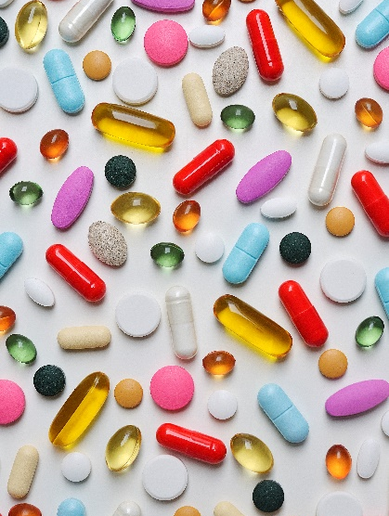
Adverse Effects
Metallic taste
Nausea
Epigastric discomfort
Constipation
Diarrhoea
Flatulence

Slide 29
Discuss side effects in advance
Discussing side effects in advance is key to managing patient expectations
Explain dark stools in advance
Discuss measures to mitigate constipation
High fibre diet, plentiful fluids
Treat constipation if required

Slide 30
Trap #4
“The more iron I give, the better.”

Slide 31
Regulation of iron absorption
Gulec S et al. Mechanistic and regulatory aspects of iron absorption. Am J Physiol 2014
Ganz T et al. Hepcidin and iron homeostasis. BAA 2012
Notes:
Ferroportin is downregulated by hepcidin

Slide 32
Second-daily dosing
Notes:
33% more iron was absorbed when iron was dosed second-daily, instead of daily or twice-daily

Slide 33
Alternate-day dosing
Stofel N et al. Iron absorption from supplements is greater with alternate day than with consecutive day dosing in iron-deficient anemic women. Haematologica 2020; 105(5)
Notes:
women with IDA (n=19; median hemoglobin 11.5 mg/dL; mean serum ferritin 10 mg/L) who received either 100 or 200 mg iron as ferrous sulfate given at 8 AM on days 2, 3 and 5
total iron absorption from a single dose of 200 mg given on alternate days was approximately twice that from 100 mg given on consecutive days

Slide 34
Alternate-day dosing
62 patients with IDA
Randomised to 60mg BD elemental iron, vs 60mg alternate daily iron
Quicker rise in Hb at 3 and 6 weeks in BD arm, particularly in those with moderate-severe IDA
Similar Hb increments seen in AD dosing arm after same total iron dose had been given
More nausea in BD arm
Kaundal R, Bhatia P, Jain A, et al. Randomized controlled trial of twice-daily versus alternate-day oral iron therapy in the treatment of iron-deficiency anemia. Ann Hematol 2020. 99: 57–63.

Slide 35
Alternate-day dosing - conclusions
Fractional iron absorption higher when iron given on alternate days
However, higher doses = increase in total iron absorbed
Consider alternate-day dosing strategy in those with mild anaemia
Higher doses may be needed when iron deficiency is severe
Pasricha et al. Iron deficiency. Lancet 2021. 397: 233-48.

Slide 36
Summary
Iron deficiency is common and affects quality of life
Consider proactively identifying at-risk groups and intervening with early iron replacement, including in pregnancy, menstruating teenagers, and vegetarians/vegans
Consider and exclude alternative causes of iron deficiency in women of childbearing age
Counsel patients on how they can maximise iron absorption
Second daily iron dosing can help to minimise side effects without compromising iron absorption

