Slide 1
Thyroid Disorders in Pregnancy and the Postpartum- an update 2023.
Presented by
Creswell J Eastman AO MB BS MD (Syd) FRACP FRCPA FAFPHM ACCAM
Clinical Professor of Medicine Sydney Medical School, The University of Sydney; Consultant Emeritus Westmead Hospital
Principal Medical Adviser the Australian Thyroid Foundation
Chairman Australian Centre for Control of Iodine Deficiency Disorders (www.accidd.org)
wwwˌthyroidmanagerˌorg

Slide 2
-
Conflict of interest statement
Member of American Endocrine Society Expert Guidelines Committee. “Management of Thyroid Dysfunction during Pregnancy and the Postpartum – an Endocrine Society Clinical Practice Guideline”.
Adviser to American Thyroid Association (ATA) Expert Guideline Committee “Thyroid dysfunction in Pregnancy and Postpartum”.
Chair NHMRC Committee on “Recommendations for Iodine Supplementation during Pregnancy”.
Author of the RANZCOG “Guidelines for iodine supplementation in pregnancy and breastfeeding”.
Principal Medical Adviser the Australian Thyroid Foundation.
No commercial or financial conflicts of interest to declare.

Slide 3
Management of Thyroid Dysfunction during Pregnancy and
the Postpartum: An American Endocrine Society Clinical Practice Guideline J Clin Endocrinol Metab 97:2543-2565,2012
2017 Guidelines of American Thyroid Association (ATA) for the diagnosis and management of thyroid disease during pregnancy and the postpartum. Thyroid 27:315-389, 2017
ACOG Committee Opinion Number 381; Subclinical Hypothyroidism during pregnancy. Obstet &Gyne 110:959—960.2007.
RANZCOG: Iodine deficiency – O&G Magazine (ogmagazineˌorgˌau)
Management of hypothyroidism in pregnancy – O&G Magazine (ogmagazineˌorgˌau)
Subclinical hypothyroidism during pregnancy: the Melbourne public hospitals consensus. Internal Medicine Journal 2019, 49:994-1000.
Eastman CJ and Zimmerman MB. The Iodine Deficiency Disorders in www.thyroidmanager.org
International and Local Guidelines available for Management of Thyroid Dysfunction in Pregnancy

Slide 4
Major Current Controversies and Challenges in Managing Thyroid disorders in Pregnancy
What we will cover in this update
Prevalence and effects of Iodine deficiency on thyroid function: during pregnancy and the postpartum
Diagnostic reference ranges for thyroid function (TSH and Free T4) in pregnancy and non-pregnant patients are different. Inappropriate/incorrect reference ranges for TSH and Free T4 are frequently quoted by some commercial labs. What reference ranges should you be using for pregnancy?
Subclinical hypothyroidism (SCH) v overt hypothyroidism (OH); how do we detect and manage both of these conditions in the pregnant woman? When should subclinical hypothyroidism be treated? Do both conditions threaten the pregnancy and the foetus or only overt hypothyroidism? What are the causes of SCH and OH?
Should we screen all pregnant women for thyroid dysfunction early in the first trimester? (Universal screening) or simply rely on targeted case detection or ignore the problem and don’t bother?

Slide 5
The First 1000 days of life is the critical time for human brain development
Impaired neurocognitive development from intrauterine/prenatal and early postnatal iodine deficiency (IDD) is the most important adverse effect of iodine deficiency on brain development.
Lack of sufficient thyroid hormone during the first 1000 days of life - the vulnerable period of foetal brain development – caused by iodine deficiency during foetal life and persisting for the two years or so after birth can cause irreversible impairment in brain function.
Where IDD is prevalent it poses a threat, not only to the health and wellbeing of the affected individual, but also to the social and economic development of whole populations.
According to the WHO, IDD is the commonest worldwide cause of preventable intellectual disability.
Approximately 50% of Australian women suffer from mild iodine deficiency at the time of conception and are not taking iodine supplements to correct it during pregnancy – and we are not making a big enough effort to address this potentially disastrous situation.

Slide 6
Overview of Spectrum of IDD clinical manifestations by life stage and dependence upon severity of iodine deficiency
Stage of Development | Clinical Disorders
Foetus | Congenital neurological disabilities, decreased IQ, high perinatal mortality, and cretinism
Newborns | Hypothyroidism, goitre, and intellectual impairment
Children and adolescents | Hypothyroidism, goitre, impaired cognitive function, and delayed physical development
Adults | Hypothyroidism, goitre, iodine-induced hyperthyroidism (after iodine replacement), impaired infertility
Elders | Multinodular goitre, autonomously functioning thyroid nodules, and susceptibility to secondary iodine induced hyperthyroidism
Pregnant women | Miscarriage, probable GDM, preeclampsia, placental abruption and stillbirth

Slide 7
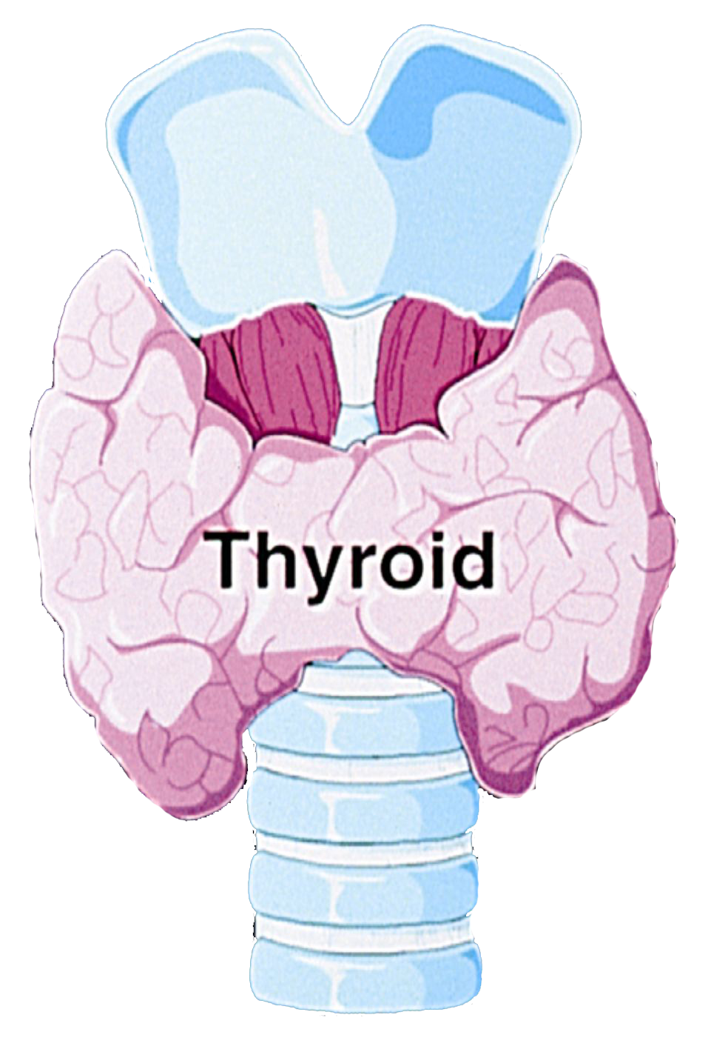
“Pregnancy: the thyroid stress test”
Pituitary TSH
hCG (acts like TSH) stimulation takes over early in pregnancy
Negative Feedback (turns off TSH, therefore TSH level is lower during early pregnancy)
Iodine
T4, T3
T4 level increases due to hCG stimulation and more carrier TBG from E2: T4 crosses placenta to foetus
Notes:
7

Slide 8
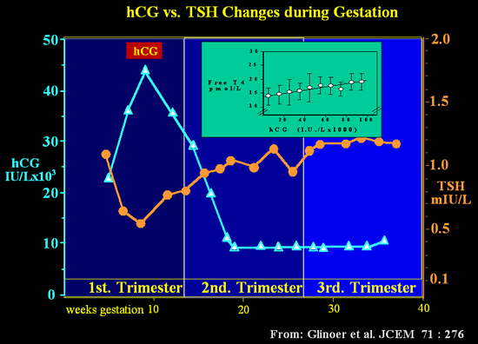
Thyroid physiology during pregnancy
TSH

Slide 9
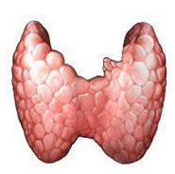
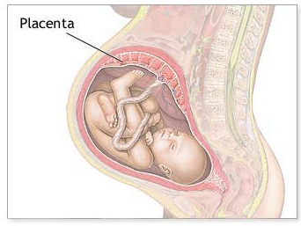
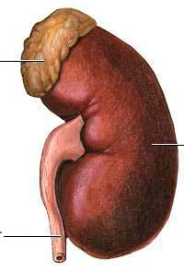
Increased demand for thyroid hormone (↑ 50%),
requires on average an additional 50-100 μg iodine per day (250ug is RDI for iodine during pregnancy v 150 ug in non-pregnant state)
- Increased thyroid stimulation by hCG raises T3 and T4 levels
- Oestrogen-mediated increased TBG production by the liver results in increased T4 and T3 levels
Contributors to Increased Maternal Dietary Iodine
Requirements in Pregnancy
Increased renal iodine clearance
(↑ 30-50%)
Iodine transferred to the foetus
(50-75 μg/day) directly and via maternal T4

Slide 10
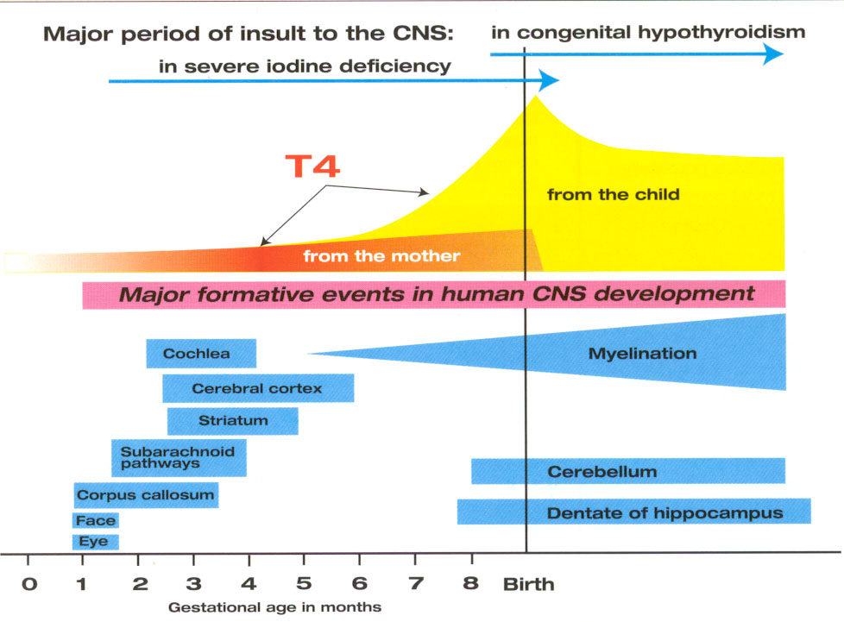
Effects of ID (decreased T4 action) on the developing human brain
level in foetus

Slide 11




Re-emergence of Iodine Deficiency in Australia in the 1990s
Dietary iodine deficiency re-emerged in Australia in the 1990s and took us all by surprise. There was no national surveillance program in place. (Tasmania had an ongoing endemic goitre surveillance system in place)
Up until the 1990s the major source of iodine in the Australian diet for the preceding 4 decades or so had been cows’ milk and other dairy products that contained iodine that leaked into the milk from iodophor sanitisers. The so-called “accidental public health triumph”.
This all went sour when the dairy industry quietly changed from iodine containing sanitisers to chlorine based sanitisers in the 1990s and did not inform the health industry of these changes.
Retrospective studies of domestic iodised salt use turned up the fact that only 10% of the household salt sold in Australia for table and cooking purposes was iodised. Why?
The food industry did not use iodised salt. “Nobody noticed and nobody seemed to care”.
Eastman CJ. “Where has all our iodine gone”? Med J Aust, Editorial 1999, vol 171:455-456.
Li M, Eastman CJ et al “Results of the National Iodine Nutrition Survey. Med J Aust. 2006, Vol 184:165-169

Slide 12
Iodine Status of Pregnant Australian Women before mandatory salt iodisation of bread in 2009
Authors | Subjects | Site | N = | Median *UIC ug/l
Gunton et al 1999 | Pregnant Post-partum | Northern Sydney | 81 28 | 104 79
Li &Eastman 1999 | Pregnant | Western Sydney | 101 | 88
Hamrosi et al 2005 | Caucasian Vietnam Ind/Sri Lankan | Melbourne Victoria | 227 263 262 | 52 58 61
Travers & Eastman et al. 2006 | Pregnant > 28 weeks | Central Coast NSW | 815 | 85
Burgess et al 2007 | Antenatal clinic | TAS | 285 | 76
Mackerras & Eastman et al 2011 | Aboriginal teenagers | N.T | 24 | 49
Nguyen et al 2010 | Pregnant antenatal clinic | ACT | 100 | 62
*UIC for pregnancy should be >150 ug/l
Notes:
12

Slide 13
Public health response to documentation of ID in Australia from the NINS study led by Westmead group in 2006
Universal Salt Iodisation (USI) was advocated to Food Standards of Australia and New Zealand (FSANZ), but was rejected by the Australian “Food Industry”.
The compromise accepted by FSANZ, State, and NZ and Australian Federal Health Ministers was mandatory iodisation of all salt used in bread baking and “baked products”. This became mandatory in Australia and New Zealand in 2008.
This has worked to protect adults and children from iodine deficiency but is inadequate to prevent gestational iodine deficiency and to protect future generations of Australian children
Voluntary iodine supplementation for all pregnant and breastfeeding women, coupled with education of the population was recommended by NHMRC in 2009 to address the problem of ID in pregnancy and while breastfeeding.

Slide 14
Iodine Intake in pregnant Australian women remains inadequate
As the recommended daily iodine intake during pregnancy and while breastfeeding is 250 ug then a significant proportion of pregnant Australian women are getting about half the daily requirement!
Iodised salt in bread has not corrected the problem for pregnancy.
Women who avoid bread and/or dairy products and/or seafood are at greatest risk of ID.
Therefore, Australian women of childbearing age, especially those who are pregnant or breastfeeding, should be taking iodine supplements. Where possible supplements should be commenced before pregnancy when planning a family.
The recommended supplement is 150 ug/day to make up to the RDI of 250 ug daily. This is line with WHO,UNICEF, ACOG, American Endo Soc, ETA, ATA, RANZCOG recommendations.
We need a better public health education campaign to get this message out to all women of reproductive age.
Remember --- “More is not better” --- excessive intake is potentially harmful and should be avoided.

Slide 15
Asia Pac J Clin Nutr 2019;28(1):xxx-xxx xxx
Mini Review
The impact of mandatory iodine fortification and
supplementation on pregnant and lactating women in Australia
Stephen Hurley BCom, MD1, Creswell J Eastman AO, MD, FRACP2,3, Gisselle Gallego PhD1
1School of Medicine, University of Notre Dame, Australia, NSW, Australia
2Sydney Medical School, University of Sydney, Sydney NSW, Australia
3Australian Representative Iodine Global Network (IGN), Chairman Australian Centre for Control of Iodine Deficiency Disorders (ACCIDD
Background and Objectives: In Australia, two public health measures were introduced between 2009 and 2010 to reduce iodine deficiency. However there has been a shortage of information regarding their effectiveness and the ongoing prevalence of iodine deficiency in Australia. The primary aim of this study was to assess the extent to which these public health measures have reduced rates of iodine deficiency among pregnant and lactating women. Methods and Study Design: A review was conducted to identify all studies published since January 2010 that quantitatively measured the iodine status of pregnant and/or lactating women in Australia. Results: We found 25 publications, of which seven were included in this review after our exclusion criteria were applied. Of the seven included publications, three demonstrated the pregnant and lactating women in their studies to be iodine replete (median urinary iodine concentrations (MUIC) greater than 150 μg/L, or a breast milk iodine concentration (BMIC) of greater than 100 μg/L). The remaining four publications found MUIC of pregnant and lactating women to be below the 150 μg/L threshold, in the mild-to-moderate iodine deficiency category. Only two studies, documented iodine sufficiency among pregnant and lactating women in the absence of iodine supplementation.
Conclusions: Many pregnant and lactating women in Australia remain at least mildly iodine deficient. Antenatal iodine supplementation was the factor most consistently associated with an adequate iodine status. Larger, more representative studies or sentinel studies with a National coordination are needed to understand the differences in iodine status that exist across the country.
Key Words: iodine, fortification, supplementation, pregnancy, Australia
INTRODUCTION
Iodine

Slide 16
Hypothyroidism- definitions
Overt primary hypothyroidism: is defined as an elevated serum TSH in combination with a Free Thyroxine (FT4) concentration below the appropriate reference range, with or without definitive clinical signs of thyroid underactivity.
Subclinical primary hypothyroidism: is commonly considered to be an early stage of thyroid gland failure and is a biochemical diagnosis defined as an elevated serum TSH concentration above the appropriate reference range in combination with a FT4 concentration within the normal reference range.
Central (secondary or tertiary) hypothyroidism: is a rare disorder due to either pituitary or hypothalamic disease.

Slide 17
Estimated Prevalence of Thyroid disorders in Australia*
Disorder | Definition | Prevalence
Overt hypothyroidism | Increased TSH and low FreeT4 | 0.5% - 1%
Subclinical hypothyroidism | Increased TSH and normal FreeT4 | 5%
Thyroid autoimmunity (Hashimoto’s disease) | Positive TPOAb or TgAb | 10-20%
Subclinical hyperthyroidism | Suppressed TSH (<0.1 mIU/L) | 0.3% (Excludes LT4 treated)
Overt hyperthyroidism | Suppressed TSH with elevated FT3 and/or FT4 | 0.3%
Palpable thyroid nodules |  | About 5%
Thyroid nodules on ultrasound (age dependent) |  | Increase with age up to 70% of elderly
*Walsh. JP Med J Aust 205:179 August 2016

Slide 18
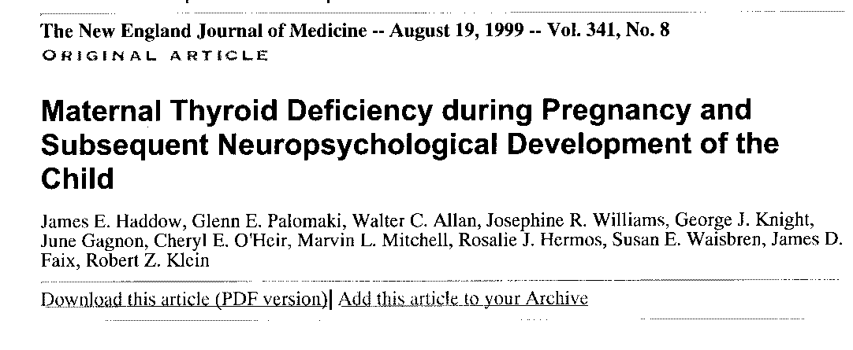
“In a retrospective observational study of over 25,000 pregnant women, undiagnosed hypothyroidism during pregnancy was shown to adversely affect their fetuses; therefore, screening for thyroid deficiency during pregnancy may be warranted”.

Slide 19
Significance of the problem – adverse effects of subclinical and overt maternal hypothyroidism.
Adverse obstetrical events
- higher rates of miscarriage
- gestational hypertension (pre-eclampsia)
- premature labour
- placental abruption
- SGA and foetal loss
Adverse foetal outcomes
- increased infant morbidity and mortality
- decreased IQ and other neurological disorders
Van den Boogard et al. Significance of subclinical and clinical thyroid dysfunction and thyroid autoimmunity before conception and in early pregnancy: a systematic review. (Human Reproduction Update Vol 17:605-619,2011)

Slide 20
Prevalence of overt and subclinical hypothyroidism in pregnancy
In the USA, 0.3 to 0.5% pregnant women are overtly hypothyroid (NHANES) and 2.5% have subclinical hypothyroidism
National Australian data is lacking
- WA study 2008, ~ 5.0% pregnant women had elevated TSH - Sydney study 1: 6.5% of pregnant women had TSH>2.5 - Sydney study 2: 9.6 % had TSH >2.5 mIU/l. 0.4% had overt hypothyroidism.
Positive thyroid antibodies: 5 to 15% of pregnant women in various series around the world; our data showed 18.2% of pregnant women in Western Sydney were TPOAb positive.
Study 1: Blumenthal, Byth and Eastman (2012). Iodine intake and thyroid function in pregnant women in Sydney before mandatory fortification of bread with iodised salt.
J Thyroid Research 2012. Article ID 798963
Study 2: Blumenthal & Eastman: Aust & NZ J. Obs and Gynae. Prevalence of thyroid dysfunction, and thyroid antibodies in a private obstetrical practice in Sydney. Vol 56:307-311, 2016

Slide 21
American Endocrine Society and ATA Guidelines for TSH reference ranges in pregnancy
When possible, population-based trimester-specific reference ranges for serum TSH should be defined through assessment of local population data representative of a healthcare provider’s practice. Reference range determinations should only include pregnant women with no known thyroid disease, optimal iodine intake, and negative TPO Ab status. (Strong recommendation, Moderate quality evidence)
American Endo Society: upper limit for TSH first trimester is 2.5 mIU/l.
European Thyroid Association: upper limit 2.5 mIU/l
American Thyroid Association (ATA) upper limit of TSH in first trimester has moved from 2.5 to 4.0 mIU/l (2011 to 2017 guidelines). However, ATA recommends use of locally derived reference ranges and only defaulting to a cut-off level of 4.0mIU/l when locally derived ranges not available.

Slide 22
Pregnancy reference ranges for TSH and Free T4
The reference range is typically statistically defined by the 2.5th and 97.5th percentiles of the measured circulating thyroid hormone values in populations defined as healthy euthyroid (iodine replete and thyroid antibody negative).
What reference range(s) should we be using in Australia?

Slide 23
Table 1. Thyroid function reference ranges for pregnancy
in Sydney commercial pathology laboratories 2018
Laboratory # | TSH reference range (mIU/l) | Free T4 reference range (pmol/l | Analytical platform
1.Laverty (Trimesters) | 0.03-2.5 0.05-3.0 0.3-3.5 | 10-21 11-18 9.2-17 | Bayer Advia Centaur
2.Medlab (Trimesters) | 0.1-2.5 0.2-3.0 0.3-3.0 | 10.0-24 | Abbott Architect
3.Aust Clinical Labs | 0.1-3.7 0.4-3.8 0.3-3.4 | 9.0-25 | Siemens
4. Douglass Hanly Moir | 0.3-2.8 0.1-2.5 0.3-2.9 | 11.0-19.0 | Abbott Architect
Labs 1&2 show an upper limit of normal of >2.5 mIU/l for TSH consistent with the American Endocrine Society Guidelines.
Laboratory 3 approximates the ATA Guidelines cut-off value of >4.0 mIU/l for SCH and Laboratory 4 has derived its own reference range that sits in between.

Slide 24
Figure 1. Results of screening of 1025 pregnant women by TSH testing during first trimester of pregnancy with application of American Endocrine Society guidelines (2012) for diagnosis and treatment*
Subclinical hypothyroid Treated with LT4
TSH (mIU/l) screening
1025 pregnant women
Euthyroid and subclinical hyperthyroid
TSH <2.5 mIU/l
N=922 (90.0%)
Euthyroid
No treatment. Ensure iodine supplements
Subclinical hypothyroid
TSH 2.5-10 mIU/l
N=99 (9.6%)
Hypothyroid
TSH >10.0 mIU/l
N=4 (0.4%)
Hypothyroid
Treated with LT4
*Blumenthal N and Eastman CJ. Beneficial effects on pregnancy outcomes of thyroid hormone replacement therapy for subclinical hypothyroidism. J Thyroid Research 2017;4601365

Slide 25
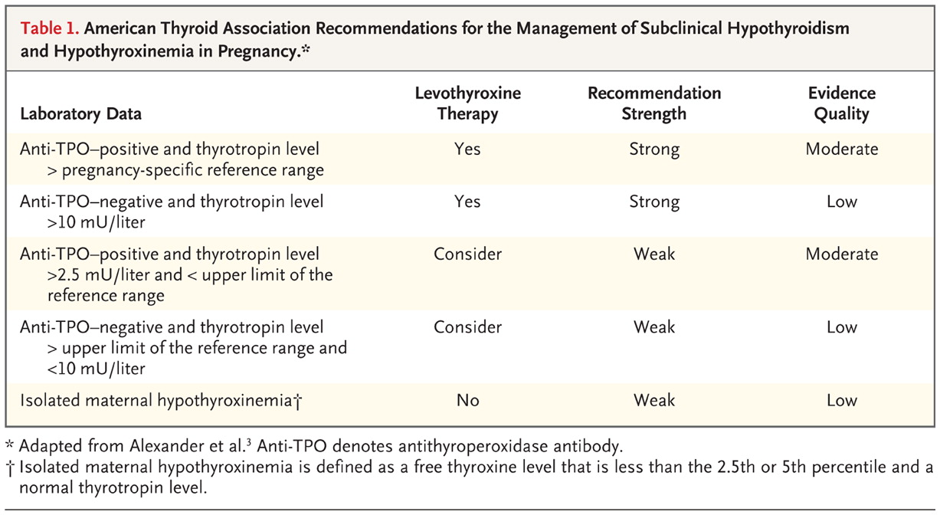
(>4.0 mIU/l)
(>10 mIU/l)
(2.5-4.0 mIU/l)
(4-10 mIU/l)
Adapted from Cooper DS and Pearce EN. Editorial: “Subclinical hypothyroidism and hypothyroxinemia in pregnancy – still no answers”. New Eng J Med 2017; 376:876-877.

Slide 26
Algorithm for thyroid hormone (LT4) replacement in pregnant women with subclinical and overt hypothyroidism
What is the TSH level in mIU?
TSH: 0.1 to 2.5 mU/L
Euthyroid
Ensure Iodine supplement
TSH 2.5-4.0 possible SCH
Recheck TSH
Measure FT4, TgAb and TPOAb
Consider/suggest LT4 if TSH >2.5 <4 and TPOAB positive. If uncertain treat with LT4
If TSH >2.5 <4 and Antibody negative: ensure iodine supplementation and review within 4 weeks. If uncertain treat with LT4
TSH 4-10
SCH
Recheck TSH and measure FT4,TgAb and TPOAb
Commence LT4 50 ug daily and monitor every 4 -6 weeks
Review diagnosis after delivery and breastfeeding
TSH >10
Hypothyroid
Measure FT4, TgAb and TPOAb and commence LT4 50 ug daily and monitor every 4 weeks
Probable lifelong LT4 medication
*This Algorithm is based on the author’s studies and his interpretation of available expert guidelines

Slide 27
LT4 therapy for pregnant women
Treat with LT4 as early as possible in pregnancy when replacement is indicated
Start with low dose LT4 50 ug daily
Do not use T3 or desiccated thyroid replacement
Monitor TSH every 4-6 weeks and adjust LT4 dose to maintain TSH level between 0.1 and 2.5 mIU/l.
Avoid overtreatment but replacement therapy appears safe*
*Blumenthal N and Eastman CJ: Beneficial effects on pregnancy outcomes of thyroid hormone replacement for subclinical hypothyroidism. J Thyroid Research 2017

Slide 28
Pregnancy and Neonatal Outcomes With Levothyroxine Treatment in Women With Subclinical Hypothyroidism (SCH) Based on New Diagnostic Criteria: A Systematic Review and Meta-Analysis.
Ding Z, Liu Y, Maraka S, Abdelouahab N, Huang H-F, Fraser WD and Fan J (2021) Front. Endocrinol. 12:797423. doi: 10.3389/fendo.2021.797423
Conclusion: LT4 treatment in pregnant women with SCH may reduce the risk of pregnancy loss, preterm delivery and gestational hypertension. Our data suggest that the benefits of LT4 supplementation may not be obvious for treated pregnant women when the diagnostic cutoff of TSH is less than 4.0mIU/L.

Slide 29
To screen or not to screen: that is the unresolved question.
None of the Guidelines advocate universal screening, but expert Committees remain divided on this.
Targeted screening is advocated according to “risk profile”. Published data indicates this strategy may miss a significant proportion of patients. (And who can remember all the possible risk factors or indicators for screening?)
Several experts argue for universal screening as a “cost effective” strategy even if it only picks up overt hypothyroidism (~ 1200 cases per year in Australia)
Testing and LT4 therapy where indicated should occur as early as possible in pregnancy

Slide 30
Take home messages (1)
Gestational iodine deficiency (ID) is the commonest worldwide cause of preventable intellectual disability
Mild gestational iodine deficiency is highly prevalent in Australia and is only being corrected in about 50% of pregnant women by iodine supplementation, despite NHMRC recommendations that virtually all pregnant women should take an iodine supplement
Subclinical and/or overt gestational hypothyroidism due to ID or autoimmune thyroiditis affects at least 5% of pregnancies in Australia.
Diagnostic testing by measuring serum TSH concentration, using pregnancy specific reference ranges, should be performed as early as possible in the first trimester. Not every expert recommends universal screening – as I do – but those who don’t recommend universal screening usually recommend targeted screening for “at risk women”.
Where LT4 replacement is indicated it should be commenced at a dose of 50 ug daily and dose adjusted by monitoring TSH and Free T4 levels every 4-6 weeks.

Slide 31
Take home messages (2)
“The application of American Endocrine Society guidelines results in possible overdiagnosis and overtreatment of SCH compared with the American Thyroid Association (ATA) guidelines where the reverse applies (possible underdiagnosis and undertreatment). We have performed a comparative analysis of data on over 1000 women from our clinic screened for thyroid dysfunction during the first trimester of pregnancy. We conclude that systematic screening for hypothyroidism by TSH testing early in pregnancy is worthwhile, being superior to recommended case-detection guidelines, and that low dose LT4 therapy should be introduced even when the degree of hypothyroidism is mild and does not cause immediate clinical manifestations in the woman. The evidence is that diagnosis and treatment should take place as soon as possible after pregnancy has been confirmed in the first trimester and should be monitored carefully throughout the pregnancy to prevent overtreatment”.
Eastman C J and Blumenthal N.2021. “Gestational Subclinical Hypothyroidism”.

Slide 32
Evidence against screening during pregnancy and against treating SCH (1)
Lazarus JH et al “Antenatal thyroid screening and childhood cognitive function”. New Eng J Med. 2012,36:493-501.
The trial consisted of screening pregnant women before 16 weeks. Women with elevated TSH were prescribed LT4 150 ug daily .
Many experts argue the trial was flawed as most participants were well into the second trimester (median gestational age at commencement was around 17 weeks) before being recruited to the trial.
This trial has been used, as with the Casey trial, as evidence NOT to treat SCH and not to screen thyroid function in pregnancy. The argument against screening has been “for a screening test to be effective, it really should only be considered if there is a proven beneficial treatment available for screened detected abnormal results”.

Slide 33
Evidence against screening during pregnancy and against treating SCH (2)
Casey et al “Treatment of Subclinical Hypothyroidism or Hypothyroxinaemia in Pregnancy”. New Eng J Med. 2017,376:815-825.
The trial consisted of screening pregnant women before 20 weeks gestation for SCH- defined as a TSH level >4.0 mIU/l with a normal Free T4 level. Women were then randomly assigned to LT4 or placebo for duration of pregnancy. Children underwent annual developmental and behavioural testing for 5 years. The primary outcome was the IQ score at 5 years of age. The secondary outcomes included preterm delivery, pregnancy complications, foetal death and neonatal morbidity and mortality.
“In conclusion on the basis of a comprehensive battery of tests through 5 years of age, we did not find significantly better neurodevelopmental outcomes in children whose mothers had received LT4 treatment for SCH or hypothyroxinaemia during pregnancy than in children whose mothers did not receive such treatment . Our trials also showed no significant effect of LT4 treatment on pregnancy and neonatal outcomes”.
This trial remains the basis for ACOG discouraging screening and treatment of SCH during pregnancy
Many experts argue the Casey trial is flawed as most participants were well into the second trimester (median gestational age at commencement was around 17 weeks) before being recruited to the trial.

