Slide 1


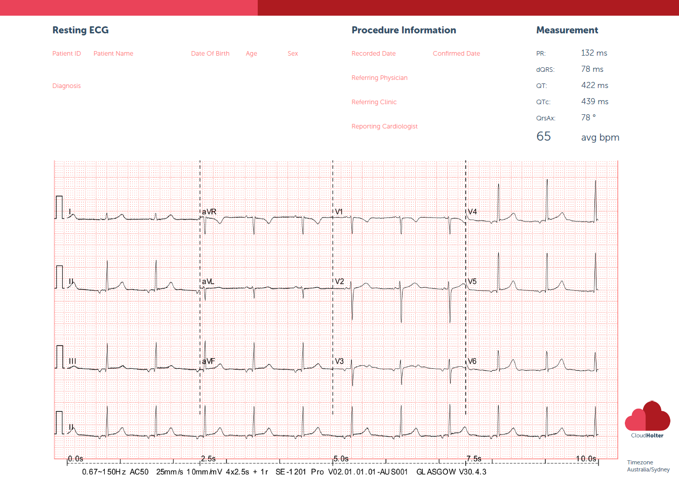
Case 1 – an 85yo male patient presents for driving medical

Slide 2
Case 1 - Question
85 yo male presents for driving medical. What does the ECG show?
Normal sinus rhythm
First degree heart block
Incorrect lead placement otherwise normal
Junctional rhythm – consider sinus node disease
WPW syndrome

Slide 3
Case 1 - answer
The correct answer is D. The ECG shows junctional rhythm or low atrial rhythm with inverted p waves in the inferior leads. Consider sinus node disease and arrange a Holter checking for chronotropic incompetence and sinus pauses. Sinus node disease is also associated with pAF.
CloudHolter now provides a bulk-billed 12-lead ECG reporting service provided at no cost to your practice. A cardiologist reports your referred 12-lead ECGs so you don’t miss anything. We provide a free new state-of-the-art 12-lead ECG machine to your practice. Visit www.cloudholter.com.au to sign up for this service.

